Slide 1
Pemrograman Berbasis Mobile
Adi Wahyu Pribadi

Slide 2
Agenda
Penilaian
Perkenalan
Flutter dan Dart
Instalasi Flutter di Local Environment

Slide 3
Bobot Penilaian
Tugas 30%
UTS 35%
UAS 35%

Slide 4
Mobile Development
Proses pengembangan aplikasi berbasis mobile untuk digunakan di berbagai gawai mobile.
https://www.joomdev.com/mobile-app-development-guide/

Slide 5
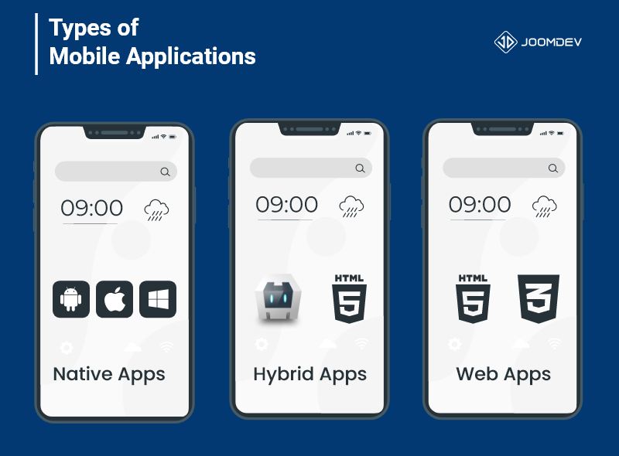
Different Types of Mobile Apps
Native apps
Hybrid apps
Web apps

Slide 6
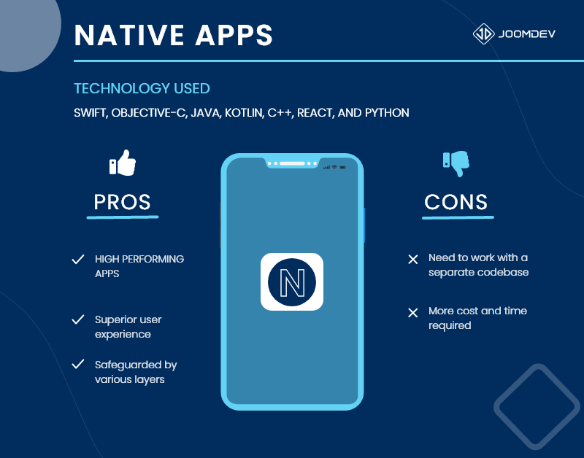



Native apps

Slide 7
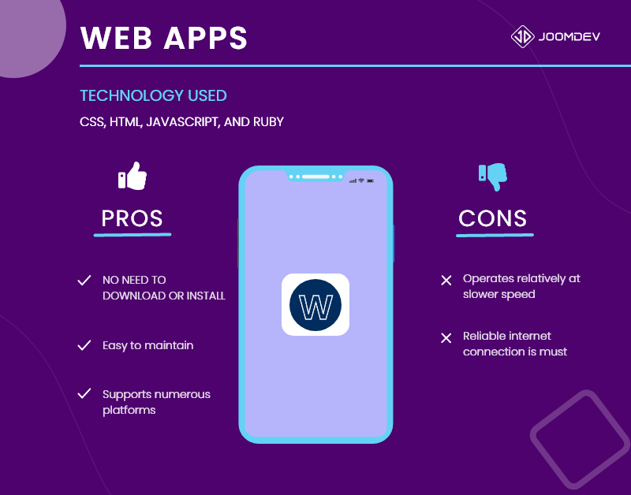



Web Apps

Slide 8
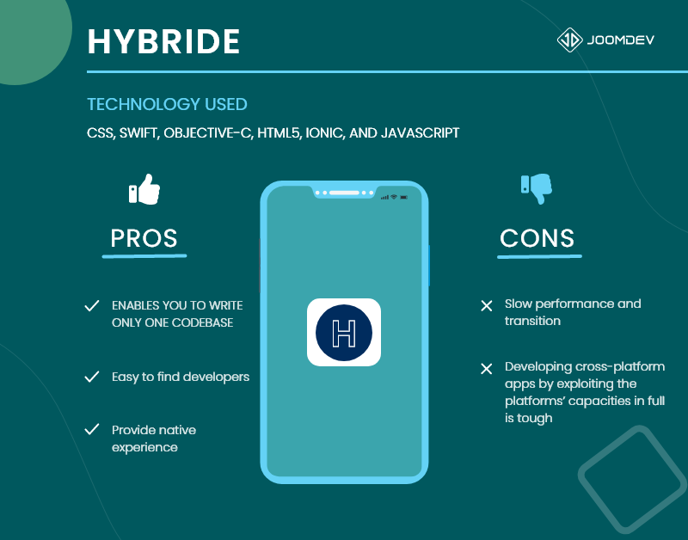



Hybrid

Slide 9
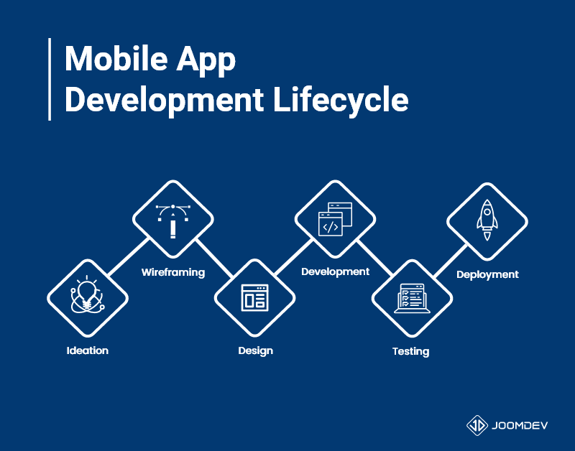
Stages of Mobile App Development Lifecycle

Slide 10
Mobile App Development Lifecycle
Stage 1: Ideation
Ideation is a creative stage that kicks off the mobile app development process. To develop a new mobile app, you must first form an idea about what kind of app you want to develop.
This stage involves techniques like SCAMPER, brainstorming, and the Worst Possible Idea to challenge assumptions and generate ideas by thinking “out of the box”. Also, you need to have a solid background of knowledge to make sure that your mobile app idea will work.

Slide 11
Mobile App Development Lifecycle
Stage 2: Wireframing & Prototyping
This stage is the foundation of your mobile app design and development stage. The idea is to map out the layout and produce a replica prototype for saving time across the entire project and ensuring a more efficient design and development stage.
To put it simply, a wireframe is a blueprint or digital sketch that illustrates the elements, functionality, and usability of an app. A prototype is a clickable, interactive, and dynamic model which closely resembles what your future app will look like.

Slide 12
Mobile App Development Lifecycle
Stage 2: Wireframing & Prototyping
Tool for wireframing & prototyping
  Figma
  https://designlab.com/figma-101-course/introduction-to-figma/

Slide 13
Mobile App Development Lifecycle
Stage 3: Design
UI and UX design with complete attention by using the latest and best design practice
Reading summarizing assignment
  https://lucidspark.com/blog/ux-design-best-practices
  https://www.uxpin.com/studio/blog/guide-design-consistency-best-practices-ui-ux-designers/
  https://xd.adobe.com/ideas/career-tips/15-rules-every-ux-designer-know/

Slide 14
Mobile App Development Lifecycle
Stage 4: Development
The biggest part is establishing the appropriate technical architecture and coding the app by embracing the latest and best mobile app development practices.

Slide 15
Mobile App Development Lifecycle
Stage 5: Testing
Testing is very essential for your app to avoid countless crashes that may arise if you skimp out on thorough testing of the app for security, performance, user acceptance, usability, compatibility, and functionality.

Slide 16
Mobile App Development Lifecycle
Stage 6: Deployment
  First launch a beta version of your app just a few short weeks before it’s anticipated launch to check how users respond to it and work out last minute issues.
  It’s mandatory to create a developer account if you want to publish your in an app store.
  Make sure you review your app adheres to app store submission guidelines: Google Play Store Guidelines | Apple’s App Store Guidelines
  It’s a good strategy to hold back some features of your mobile app to make room for further development and launching of an updated version soon.

Slide 17
Mobile App Development Lifecycle
Stage 7: Post Launch
A winning app is one that is not only well developed but also has well-placed support, maintenance, marketing, innovation, and continuous improvement. The post-launch activities will include pitching your app, App Store Optimization (ASO), providing frequent updates, gathering feedback, understanding users’ reactions, solving customer queries, and planning for your growth.

Slide 18
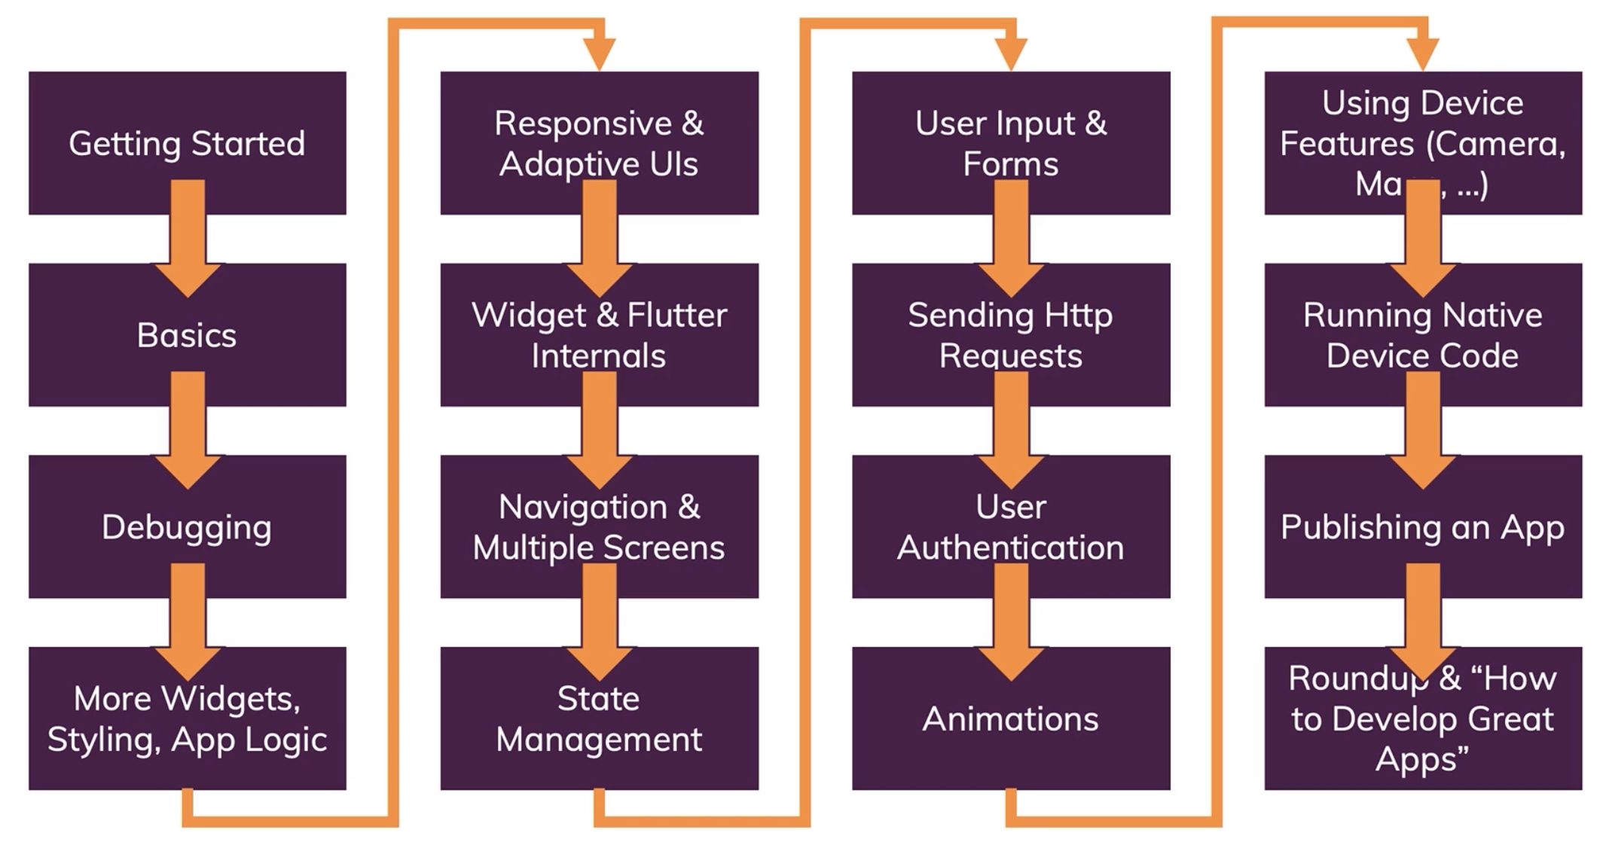
Courses Structure

Slide 19
What is Flutter?

Slide 20
A tool that allows you to build native cross-platform (iOS, Android) apps with one programming language and code base.
A SDK (Software Development Kit)
A Framework/Widget Library
Tools to compile your code to native machine code + develop with ease
Re-usable UI building blocks (=widgets), utility functions, packages

Slide 21

Dart
Programming language developed by Google
Focused on frontend (mobile apps, web) user interface (UI) development

Slide 22
Flutter vs Dart
Flutter Framework
A framework (set of features)
A Dart framework, providing utility functions & UI elements (widgets)
Flutter
Dart
The programming language
Flutter SDK
A set of tools

Slide 23
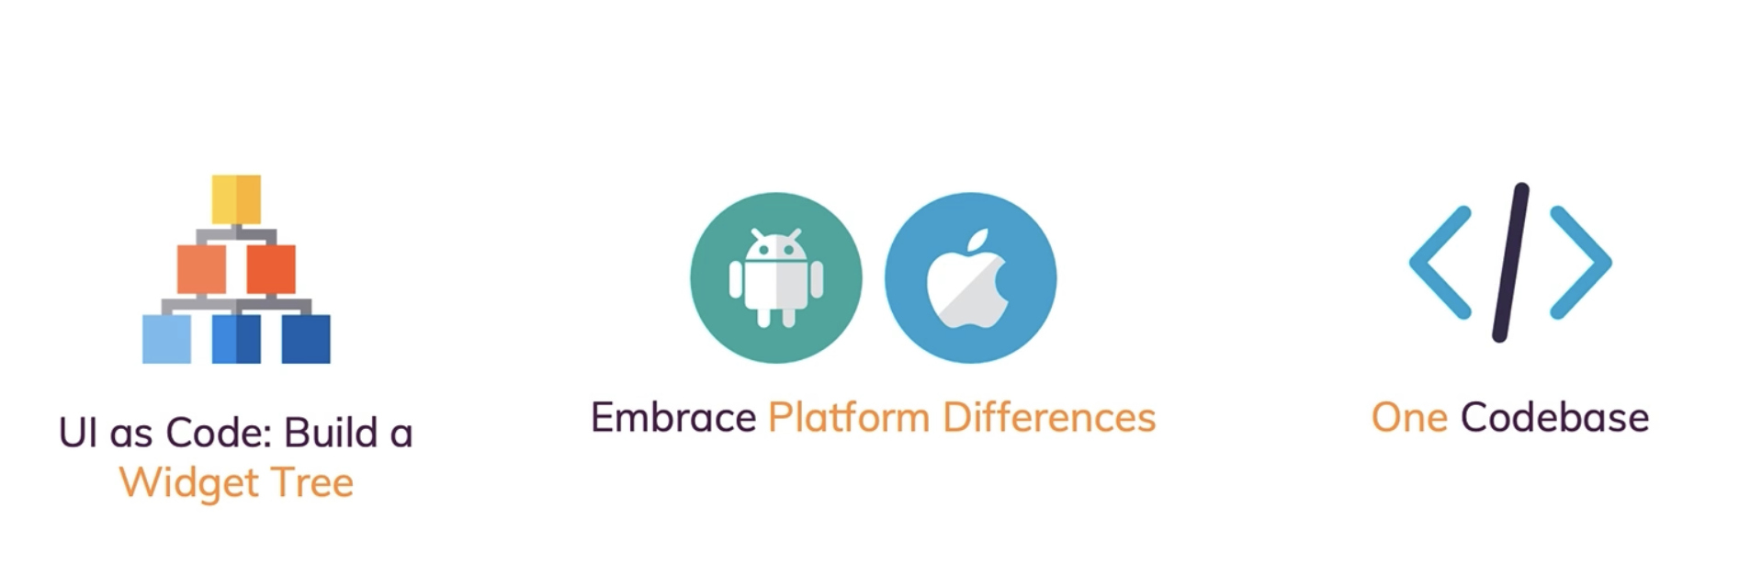
Flutter Architecture

Slide 24
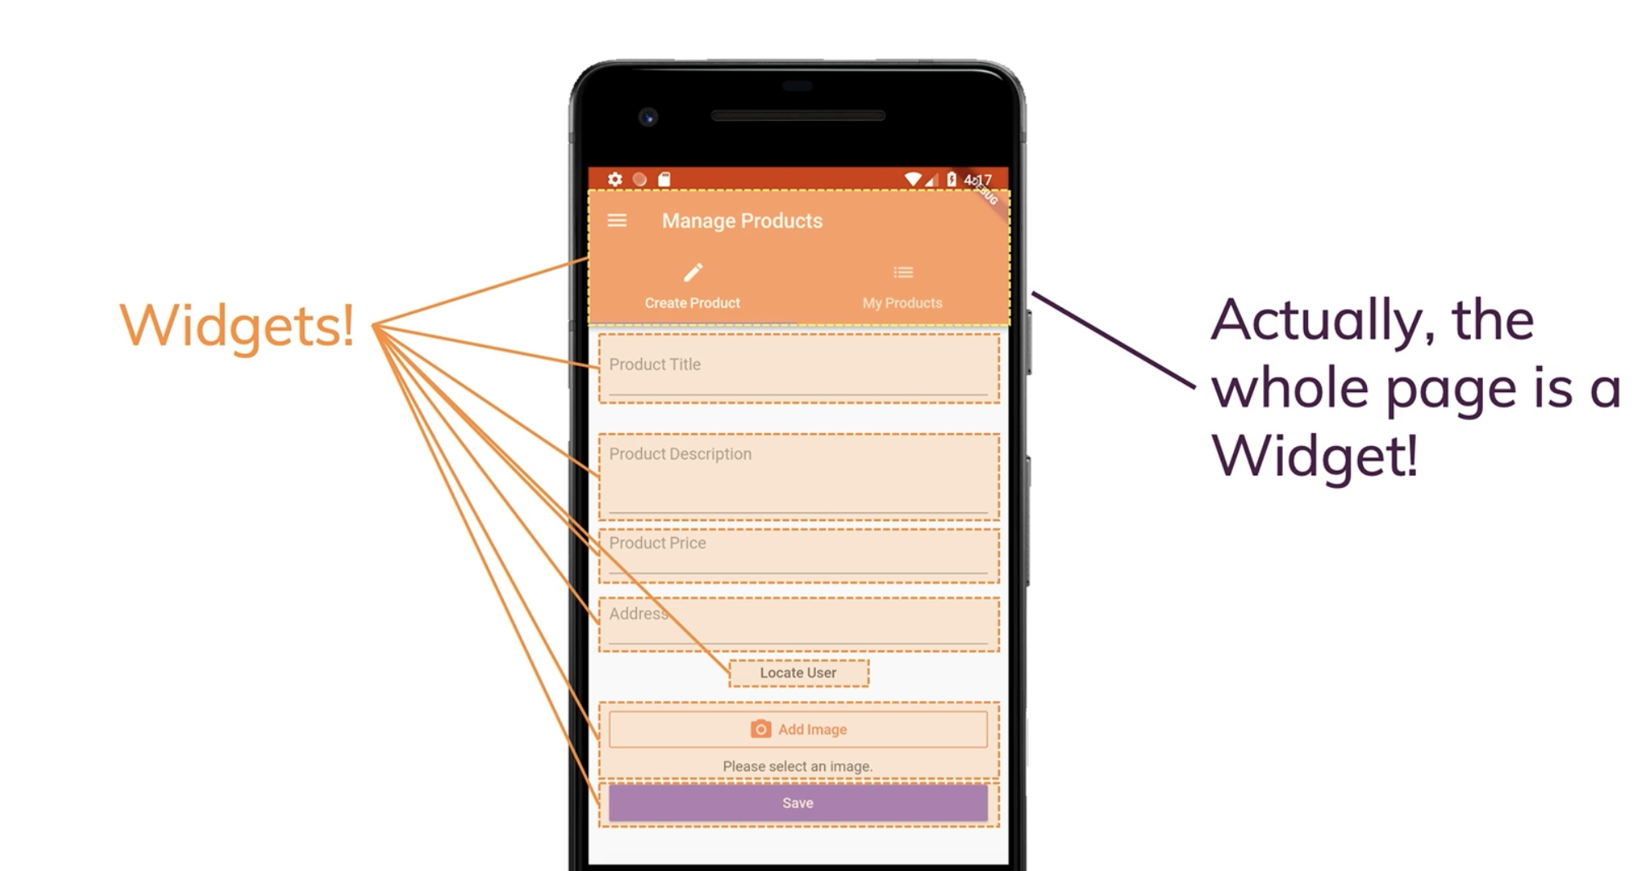
Everything is a Widget!

Slide 25
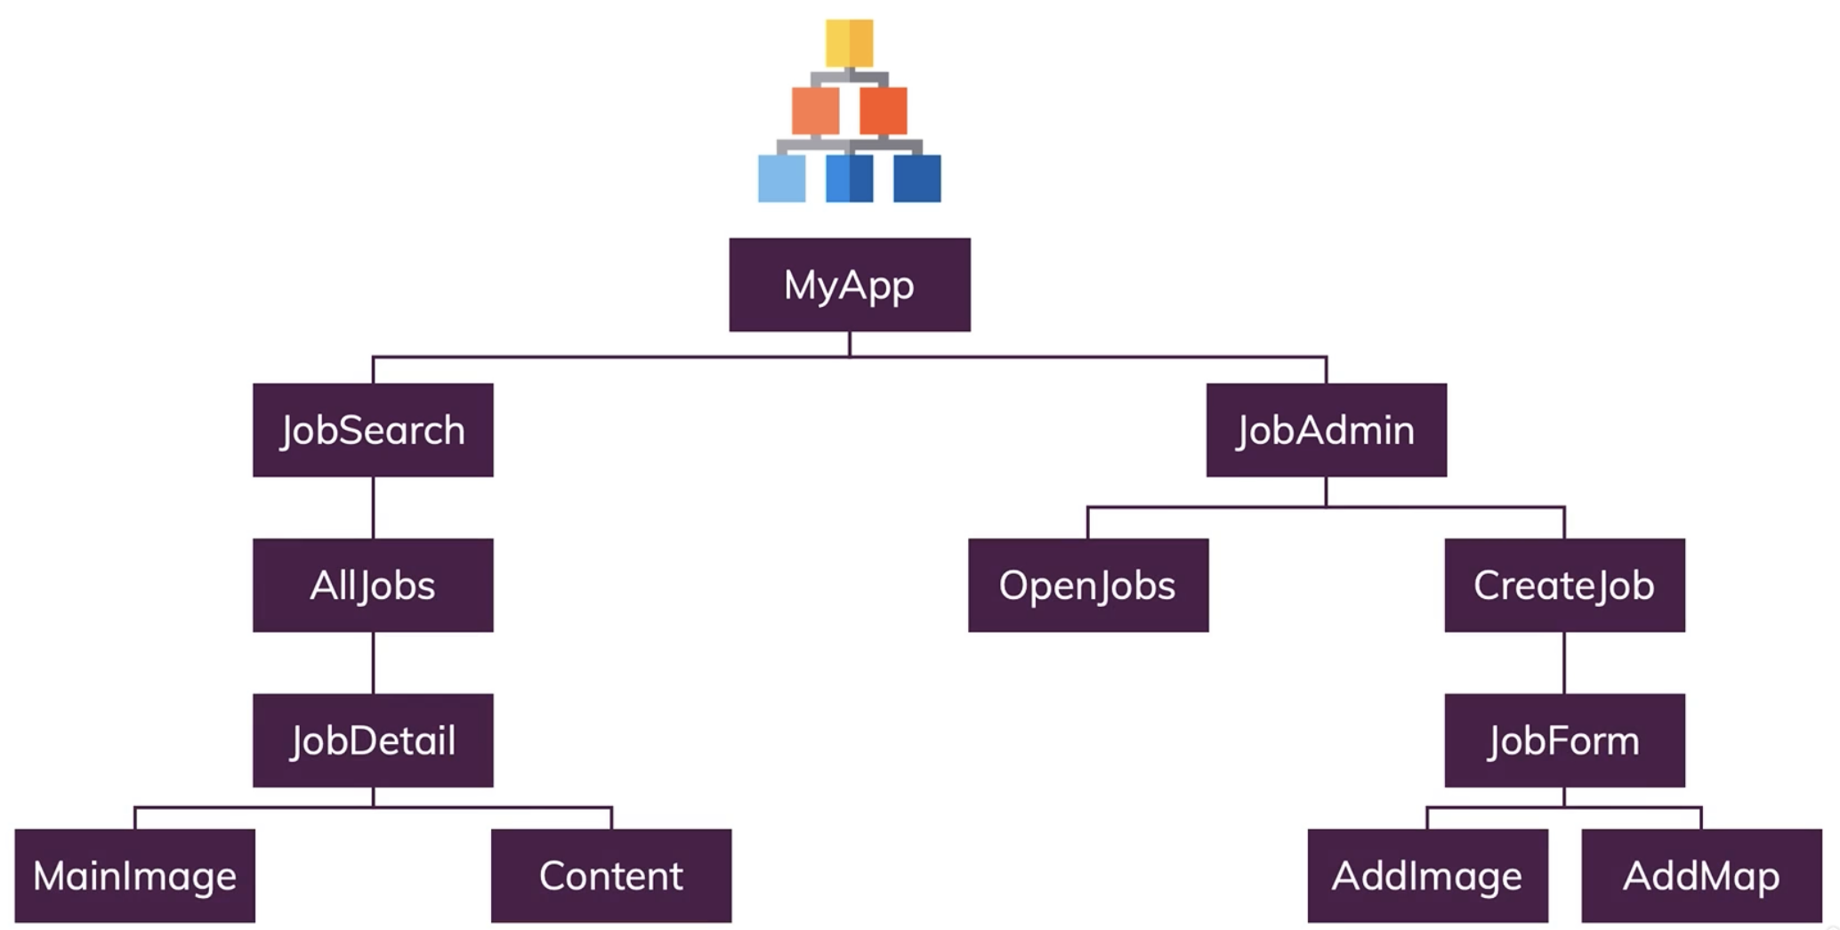

Slide 26
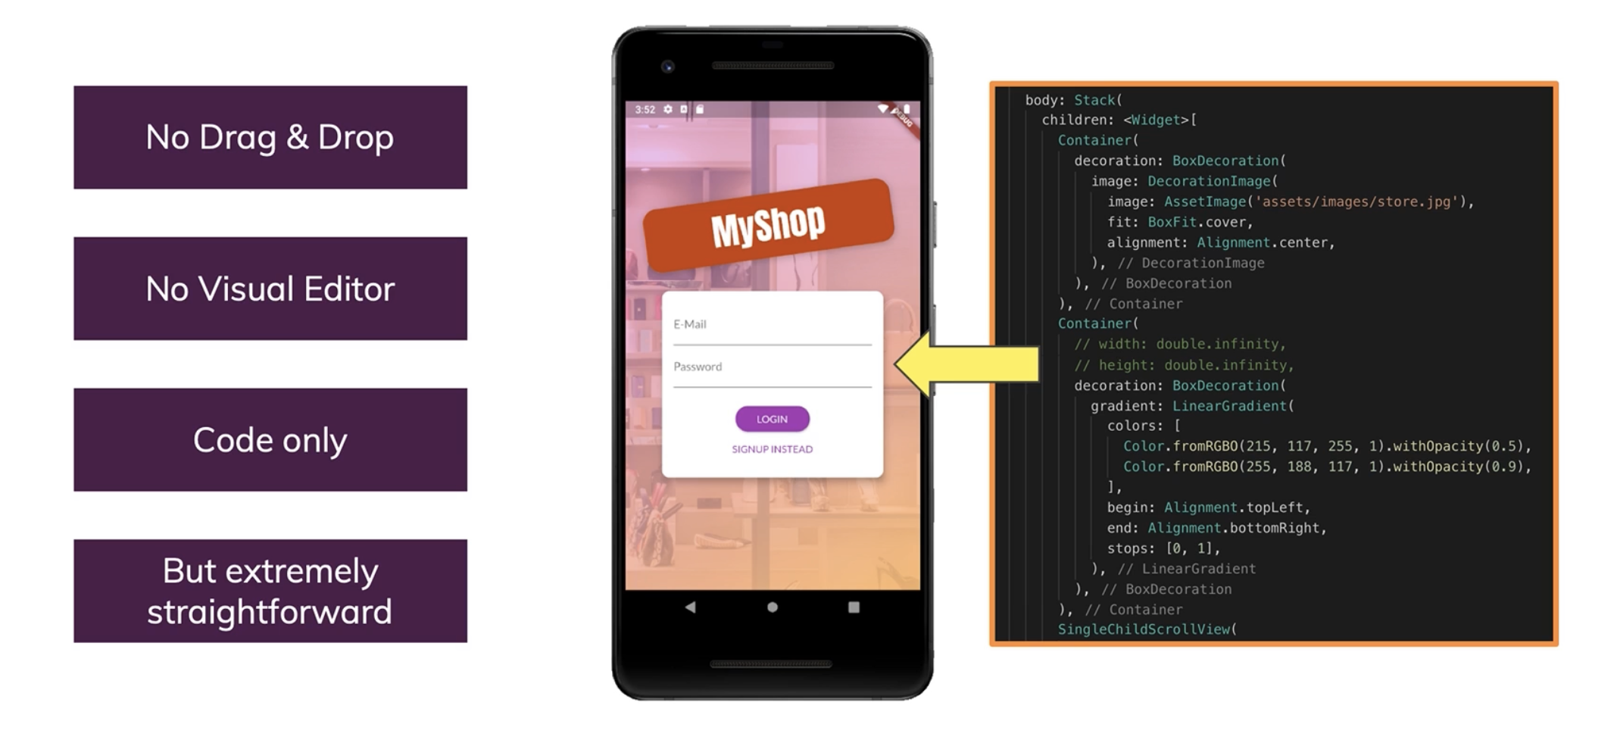

Slide 27
The Basics

Slide 28
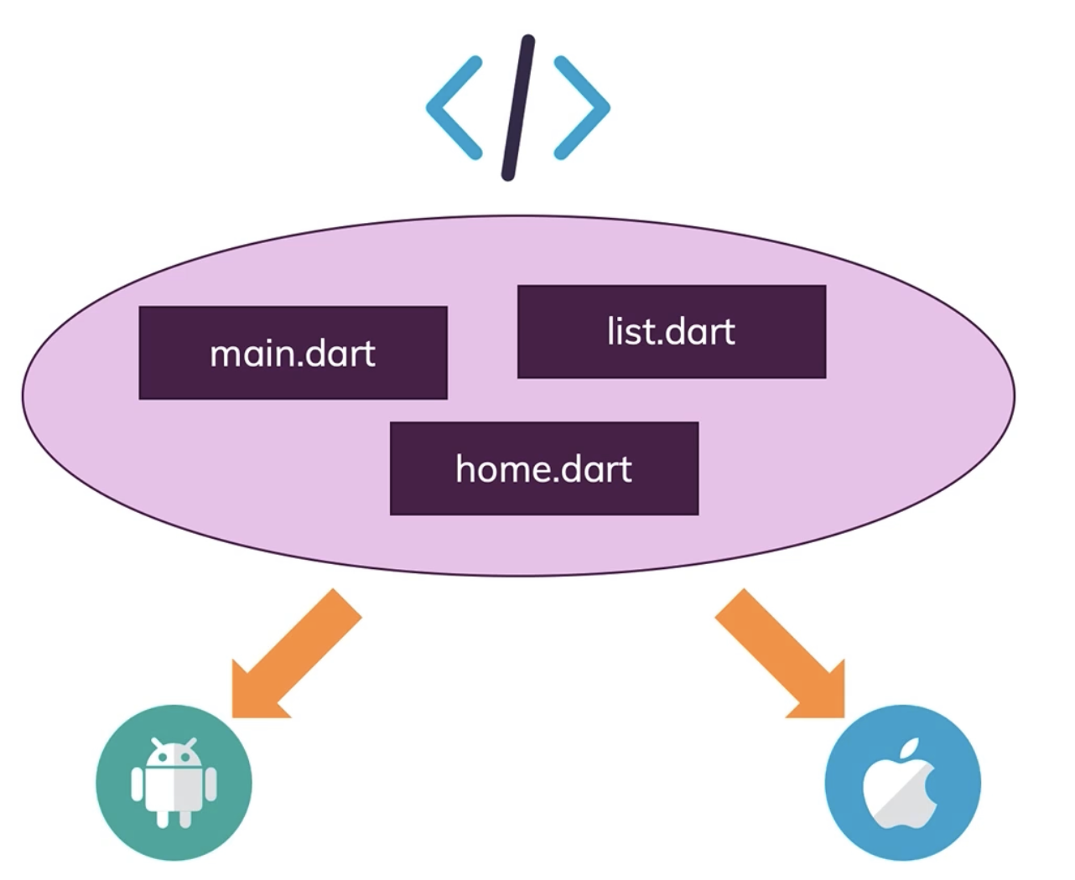

Slide 29
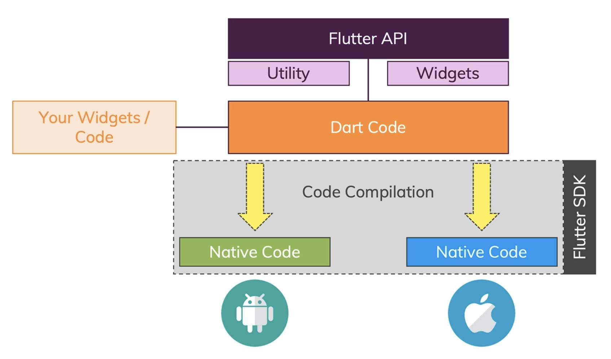
Transform Flutter/Dart to a Native APp

Slide 30
Tugas
Install Flutter Development Environment on your own system!
https://docs.flutter.dev/get-started/install
  Get the flutter SDK
  Run flutter doctor
  Android Setup
    Install Android Studio
    Set up your Android
    Set up the Android Emulator
    Agree to Android Licenses
  Set up an Editor (VS Code or Android Studio)
  https://docs.flutter.dev/get-started/editor?tab=androidstudio
    Install the Flutter and Dart Plugins
  Test Drive
  https://docs.flutter.dev/get-started/editor?tab=androidstudio
    Create the App
    Run the App

Slide 31
Tugas
Laporan dalam format Microsoft Word kertas A4, Times New Roman, 12pt.
Lampirkan screen shot setiap langkah
Screen shot harus full satu halaman desktop
Dikumpulkan minggu depan

Slide 32
Dart Basics

Slide 33
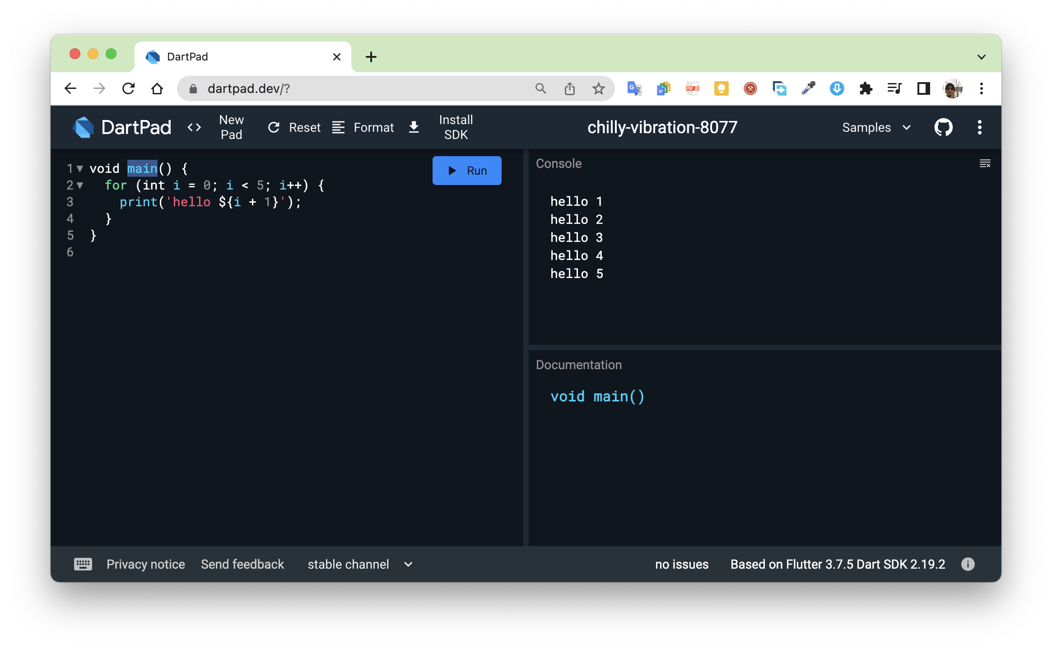
Dartpad.dev
Bisa gunakan Dartpad.dev untuk latihan langsung Bahasa Dart secara online

Slide 34
Data Types
A program works with different types of data
Text
  Strings: “Hello World!”
Numbers
  Integers: 29
  Floats: 29.99

Slide 35
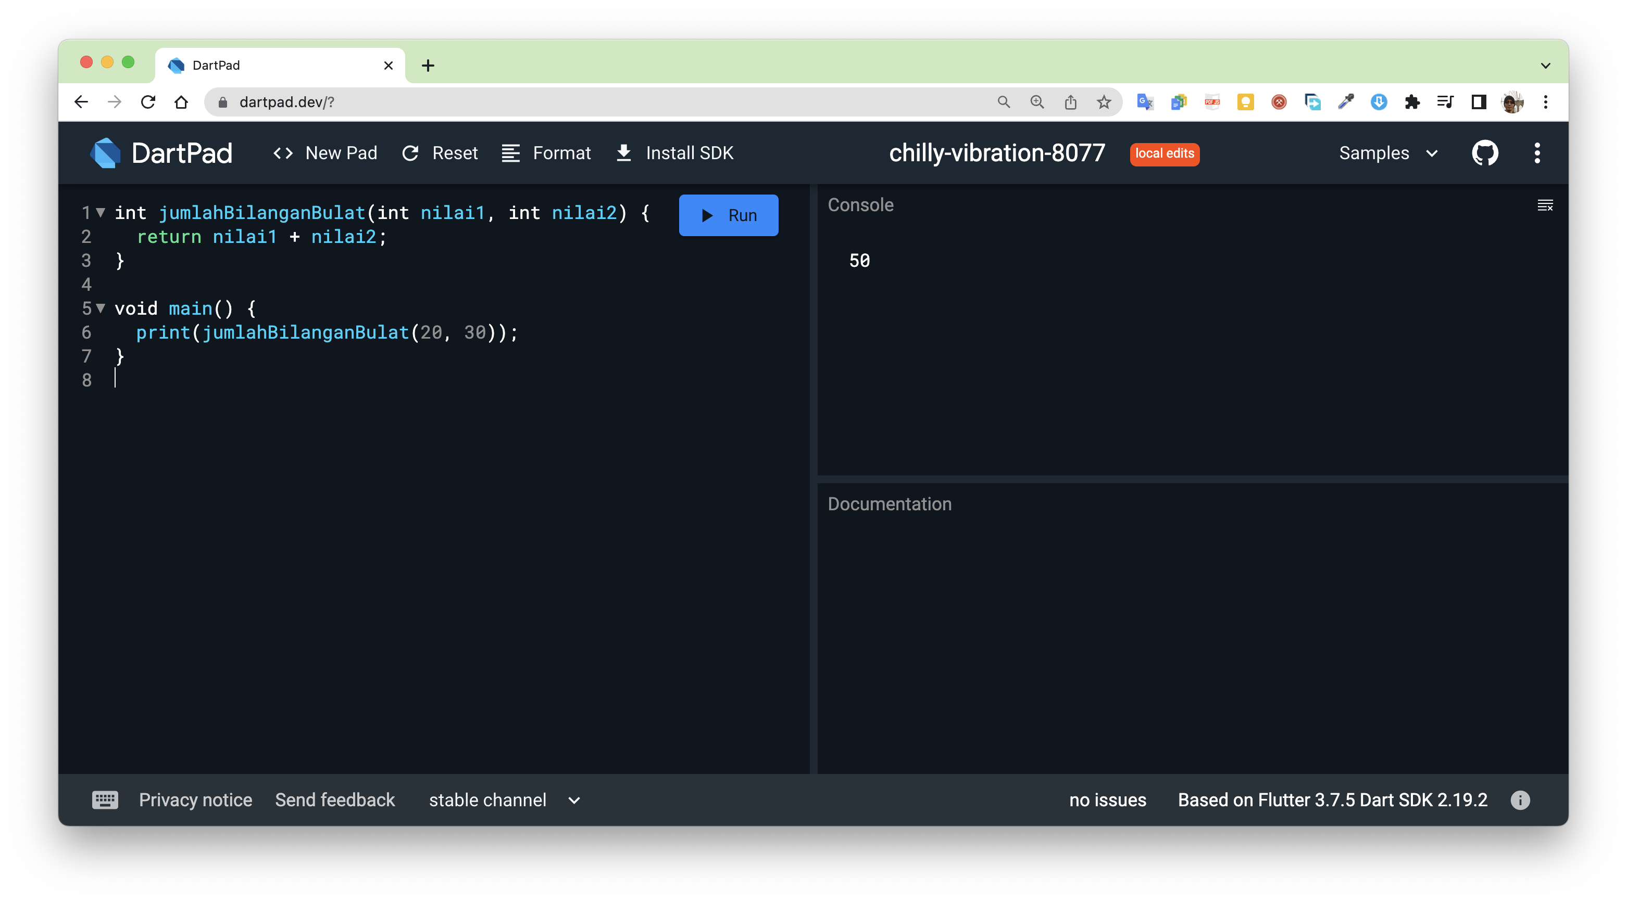
Main function
main() function adalah fungsi utama yang special di mana berfungsi sebagai titik masuk pertama kali ketika program Dart dijalankan.

Slide 36
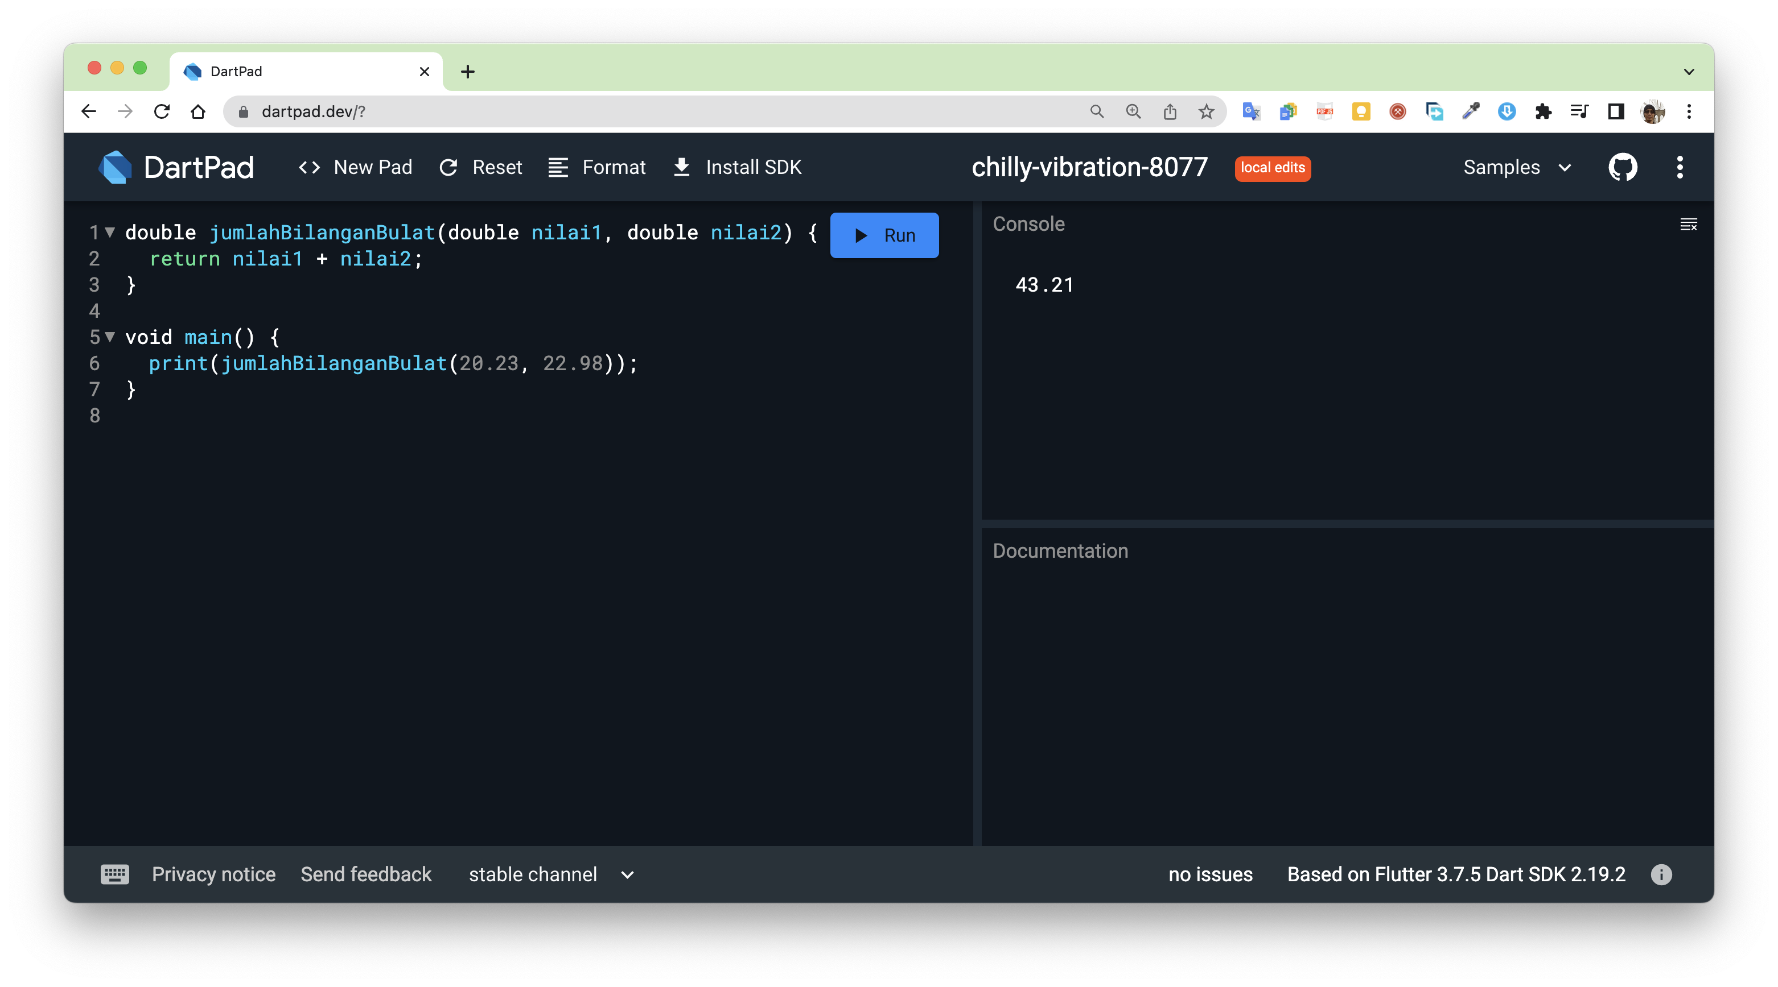
Main function
main() function adalah fungsi utama yang special di mana berfungsi sebagai titik masuk pertama kali ketika program Dart dijalankan.

