Slide 1
Introduction

Slide 2
Objectives
Know the difference between analysis, design, and development
Having good understanding of OOP
  What is an Object
  What is a Class
    Abstraction
    Encapsulation
    Inheritance
    Polymorphism

Slide 3
Jargon
Association
Encapsulation
Polymorphism
Abstraction
Singleton
Aggregation
Inheritance
Cardinality
Destructor
Composition
Chain of Responbility
Constructors
Class Responsibility Collaboration

Slide 4
Prerequisite
Basic Programming
  Variables
  Function
  Loops
  Conditional
  Operators
  ...

Slide 5
Code vs Design

Slide 6
Code vs Design
Code
  Know the language
  Syntax of particular language
  Know how to write the code to solve the problem
Design
  What is the problem
  What is the solution
  How is the process

Slide 7
Object Oriented

Slide 8
Object Oriented
Object Oriented Analysis
  Understand the problem
Object Oriented Design
  Plan how to solve the problem
Object Oriented Programming
  Build the program

Slide 9
Software Development Methodologies
Is there one process/method/road map to develop software from?

Slide 10
Software Development Methodologies
SCRUM
EXTREME PROGRAMMING (XP)
SSADM
Unified Process
Agile Unified Process
Feature Drive Development (FDD)
Cleanroom
Adaptive Software Development
Crystal Clear
Behavior Driven Development
Rapid Application Development

Slide 11
Why So Many?
Create games on Android Device
Create High Secure Nuclear Reactor Power Plan Software
Create real time analysis of F1 car to improve performance and detect malfunction processes
Create information system of trading in your office

Slide 12
Complex Process
X
Software Development Lifecycle
Project Management
Documentation Requirement
People Management
Budgeting

Slide 13
What we Learn
Understand the problem
Design the solution

Slide 14
Method we Use
Agile Iterative Process
Not Waterfall Process

Slide 15
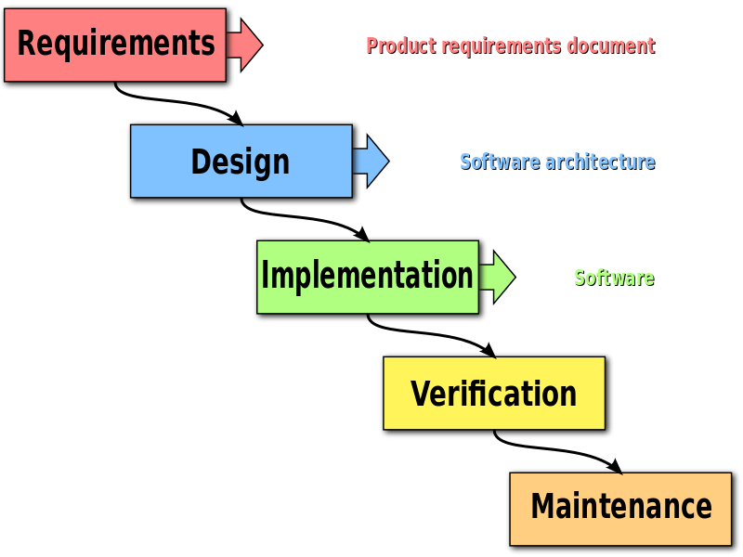
Waterfall Approach

Slide 16
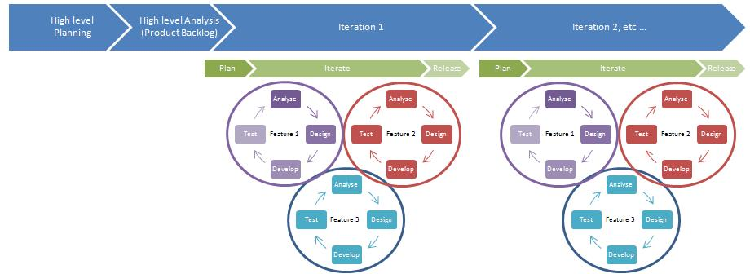
Agile Iterative Development

Slide 17
Object Oriented Language
In procedural language when programs get bigger and bigger, they are difficult to manage and difficult to plan
OOP gained popularity in 1980s as new approach to solve those problems
C++, C#, Java, JavaScript, Perl, PHP, Python, Objective-C, Ruby, VB .Net, and many others

Slide 18




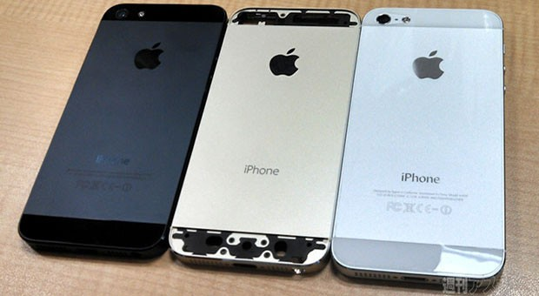
What is an Object?
Object is thing

Slide 19
What is an Object?
Object has its own identity
Object has its own state
  Object has properties
  Object has characteristics
  Object has attributes
  The state of an Object is independent from other objects: A lamp is off won't make all the lamps in the world off
Object has behavior
  Phone can ring
  A plane can fly

Slide 20
Are these objects?
TIME
DATE
BANK ACCOUNT
EVENT

Slide 21
Computing Objects
Balance: Rp.100.000
Number: 123-998212
Deposit()
Withdraw()
Name: Bob
Gender: Male
Walk()
Run()
Eat()
Name: Aline
Gender: Female
Walk()
Run()
Eat()
ID OBJECT
ID OBJECT
ID OBJECT

Slide 22
Objects
Are Not Always Physical items
Are Not Always Visible items
IDEA
NOUN

Slide 23

What is a Class?
Blueprint
Detail description
Definition
Define a class once and create one or many objects
Blueprint to create one or many houses

Slide 24
Creating a Class?
(Type) Name: What is it?
  Employee, BankAccount, Event, Player, Album
(Properties, Data) Attributes: what describes it?
  Width, color, score, length
(Operations) Behavior: What it can do?
  Play, Open, Search, Print, Create, Delete, Close

Slide 25
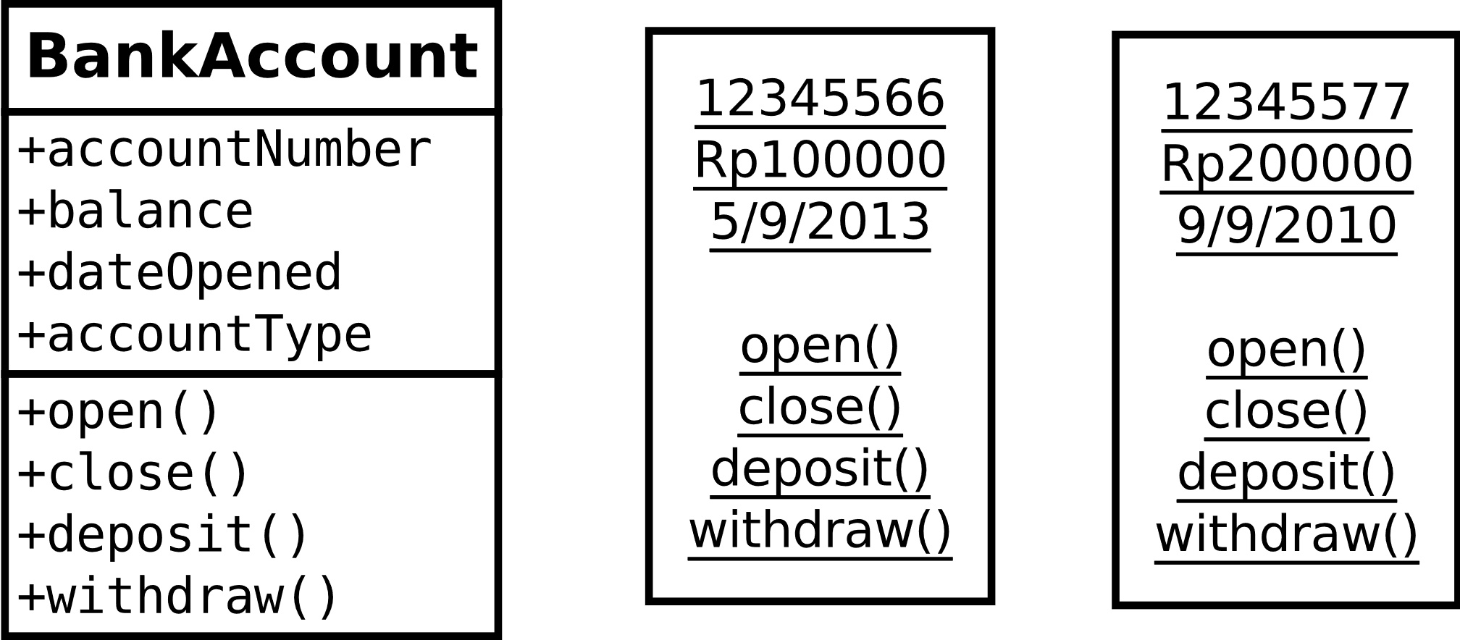
Creating a Class
Creating object = instantiation
Class
JhonAcc
AlineAcc
Objects (instance)

Slide 26
4 Fundamentals of OOP
Abstraction
Encapsulation
  Encapsulation is the packing of data and functions into a single component
Inheritance
  when an object or class is based on another object or class, using the same implementation (inheriting from a class) or specifying implementation to maintain the same behavior (realizing an interface; inheriting behavior)
Polymorphism
  the provision of a single interface to entities of different types

Slide 27
Existing Classes in OO Languages
Most OOP languages provide many pre-written generic classes at minimum: strings, dates, collections, file I/O, networking, (many more)
  Java Class Library
  .NET Framework BCL
  C++ Standard Library
  Ruby Standard Library
  Python Standard Library

