Slide 1
Save Password di Database
Keamanan Teknologi Informasi

Slide 2
Cara konvensional
aplikasi
Plaintext
Username: adiwp
Password: Passadiwp123
username
password
SELECT
username, password
FROM
Tbl_user
Where
id = “InputUsername”
submit
Tbl_user
id | password
adiwp | Passadiwp123#
amirmur | Mir123#
InputUsername: adiwp
InputPassword: Passadiwp123
dtUsername
dtPassword
dtUsername = InputUsername
&&
dtPassword = InputPassword

Slide 3


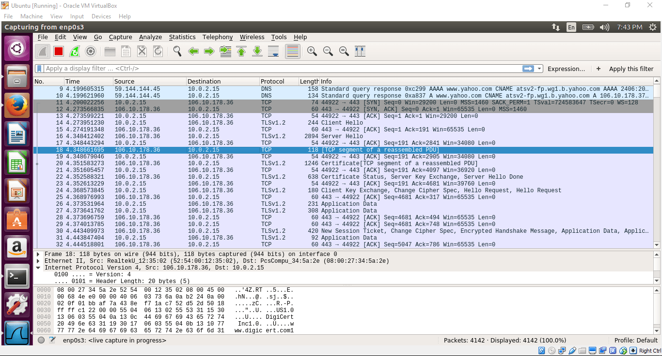

InputUsername: adiwp
InputPassword: Passadiwp123

Slide 4
Hashing Password
Username: adiwp
Password: passadiwp123#
Sebelum disimpan di table database
Hash(passadiwp123#) = 30410ehqwhxem0qwue0que0u1
Tbl_user
id | password
adiwp | 30410ehqwhxem0qwue0que0u1
amirmur | Ijqwijr022cnuce1eic1

Slide 5
Passadiwp123#
30410ehqwhxem0qwue0que0u1
InputUsername: adiwp
Hash(InputPassword): 30410ehqwhxem0qwue0que0u1

Slide 6
aplikasi
username
Username: adiwp
Password: 30410ehqwhxem0qwue0que0u1
password
submit
MD5 dan SHA1 → sudah rentan
BCRYPT ➔ Hash yang bagus
Hash(passadiwp123#) = 30410ehqwhxem0qwue0que0u1
Hash(30410ehqwhxem0qwue0que0u1) = sadojqowijex0i30h2i0xerj2i3jxrqo3

Slide 7
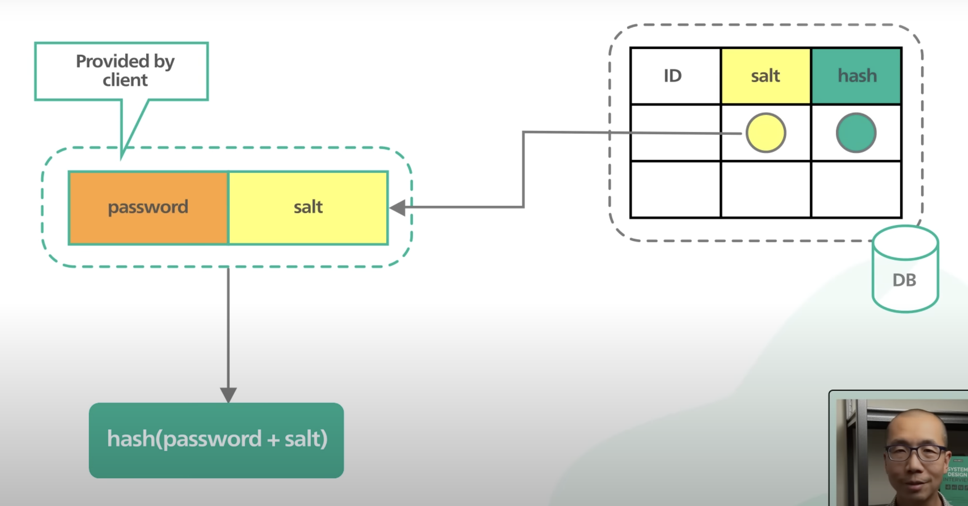
Hash(pass + salt)

