Slide 1

Object-Oriented Modeling
Structure Modeling
Slides accompanying UML@Classroom
Version 1.0

Slide 2
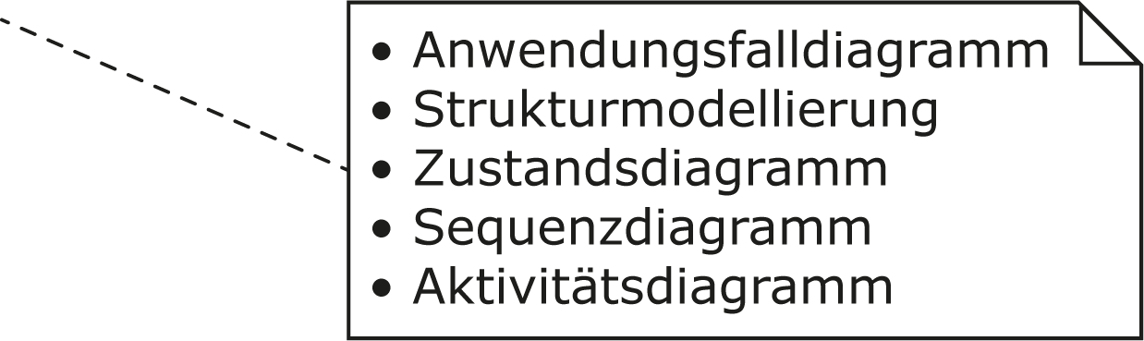
Literature
The lecture is based on the following book:
UML @ Classroom:
An Introduction to Object-Oriented Modeling
Martina Seidl, Marion Scholz, Christian Huemer and Gerti Kappel
Springer Publishing, 2015
ISBN 3319127411
Use Case Diagram
Structure Modeling
State Machine Diagram
Sequence Diagram
Activity Diagram

Slide 3
Content
Objects
Classes
Attributes
Operations
Relationships
  Binary Association
  N-ary Association
  Association Class
  Aggregation
  Generalization
Creating a class diagram
Code Generation

Slide 4

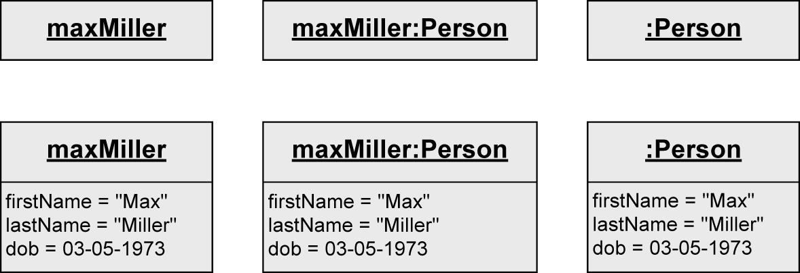
Object
Individuals of a system
Alternative notations:
Object name
Class
Anonymous objects
= no object name
Attribute
Current value

Slide 5

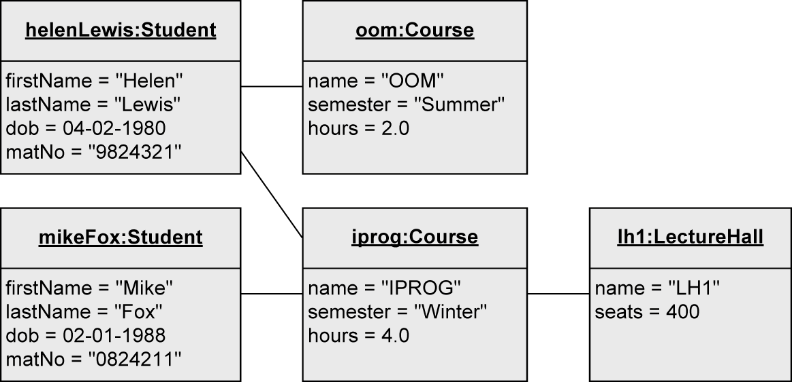
Object Diagram
Objects of a system and their relationships (links)
Snapshot of objects at a specific moment in time
Link

Slide 6
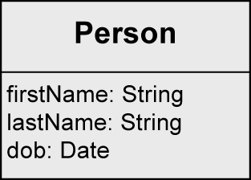
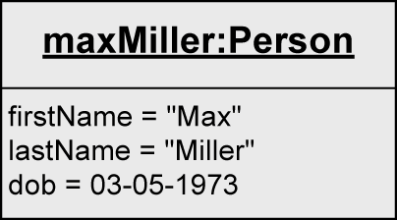
From Object to Class
Individuals of a system often have identical characteristics and behavior
A class is a construction plan for a set of similar objects of a system
Objects are instances of classes
Attributes: structural characteristics of a class
  Different value for each instance (= object)
Operations: behavior of a class
  Identical for all objects of a class
  → not depicted in object diagram
Class
Object of that class

Slide 7
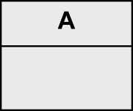
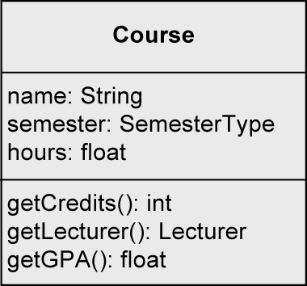
Class
Class name
Attributes
Operations

Slide 8
Attribute Syntax

Slide 9
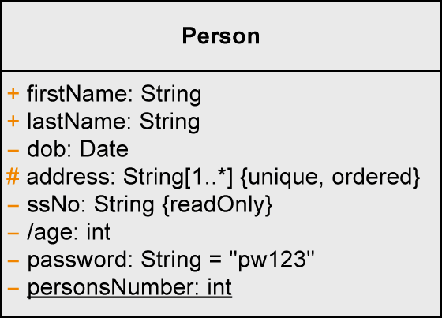
Attribute Syntax - Visibility
Who is permitted to access the attribute
  + ... public: everybody
  - ... private: only the object itself
  # ... protected: class itself and subclasses
  ~ ... package: classes that are in the same package

Slide 10
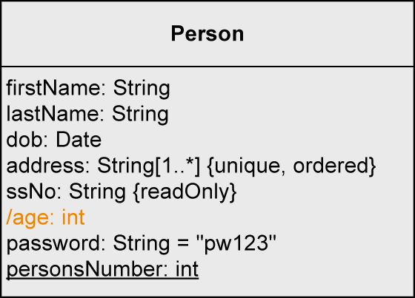
Attribute Syntax - Derived Attribute
Attribute value is derived from other attributes
  age: calculated from the date of birth

Slide 11
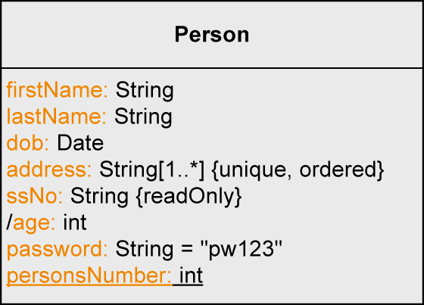
Attribute Syntax - Name
Name of the attribute

Slide 12
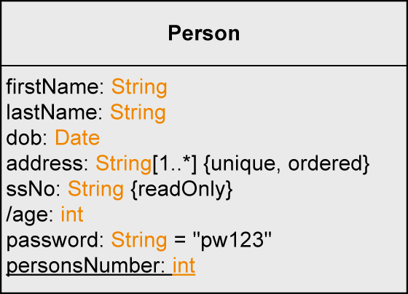
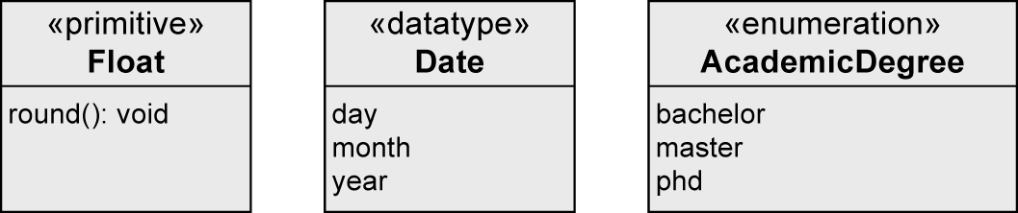
Attribute Syntax - Type
Type
  User-defined classes
  Data type
    Primitive data type
      Pre-defined: Boolean, Integer, UnlimitedNatural, String
      User-defined: «primitive»
      Composite data type: «datatype»
    Enumerations: «enumeration»

Slide 13
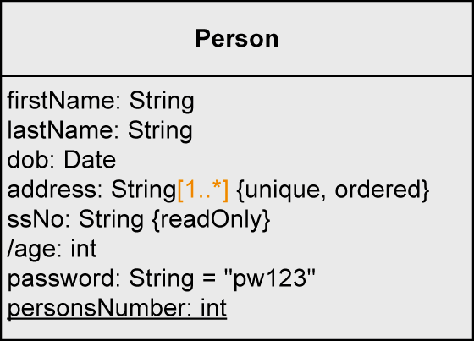
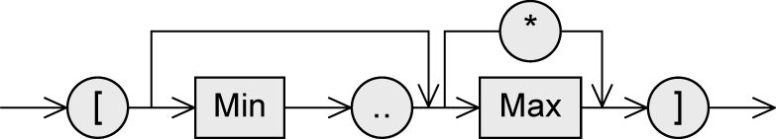
Attribute Syntax - Multiplicity
Number of values an attribute may contain
Default value: 1
Notation: [min..max]
  no upper limit: [*] or [0..*]

Slide 14
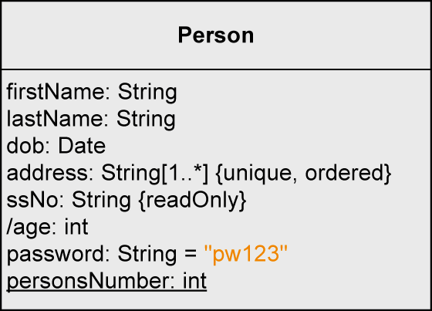
Attribute Syntax – Default Value
Default value
  Used if the attribute value is not set explicitly by the user

Slide 15
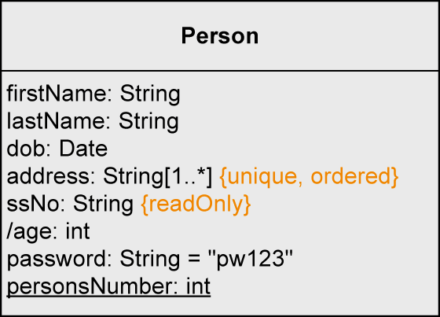
Attribute Syntax – Properties
Pre-defined properties
  {readOnly} … value cannot be changed
  {unique} … no duplicates permitted
  {non-unique} … duplicates permitted
  {ordered} … fixed order of the values
  {unordered} … no fixed order of the values
Attribute specification
  Set: {unordered, unique}
  Multi-set: {unordered, non-unique}
  Ordered set: {ordered, unique}
  List: {ordered, non-unique}

Slide 16
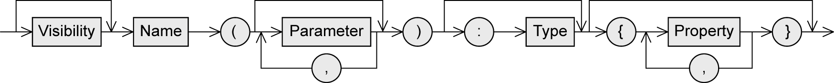
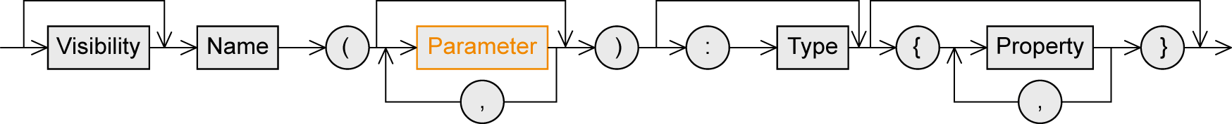
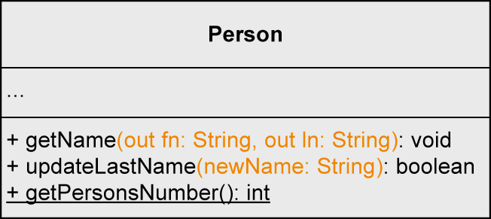
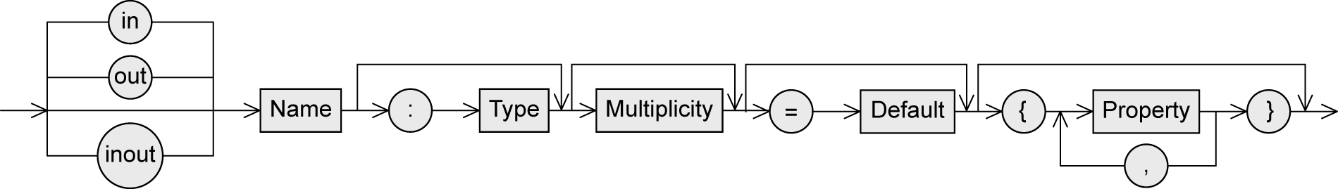
Operation Syntax - Parameters
Notation similar to attributes
Direction of the parameter
  in … input parameter
    When the operation is used, a value is expected from this parameter
  out … output parameter
    After the execution of the operation, the parameter has adopted a new value
  inout : combined input/output parameter

Slide 17
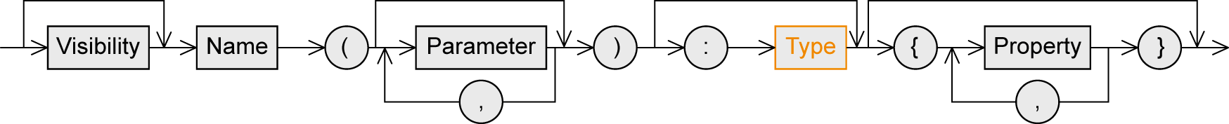
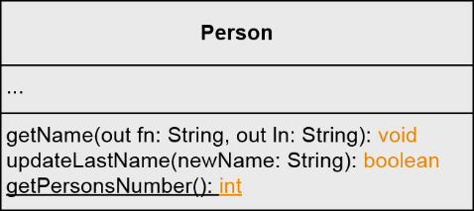
Operation Syntax - Type
Type of the return value

Slide 18
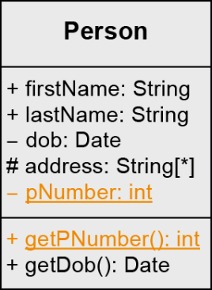
Class Variable and Class Operation
Instance variable (= instance attribute): attributes defined on instance level
Class variable (= class attribute, static attribute)
  Defined only once per class, i.e., shared by all instances of the class
  E.g. counters for the number of instances of a class, constants, etc.
Class operation (= static operation)
  Can be used if no instance of the corresponding class was created
  E.g. constructors, counting operations, math. functions (sin(x)), etc.
Notation: underlining name of class variable / class operation
class Person {
public String firstName;
public String lastName;
private Date dob;
protected String[] address;
private static int pNumber;
public static int getPNumber() {…}
public Date getDob() {…}
}
Class variable
Class operation

Slide 19
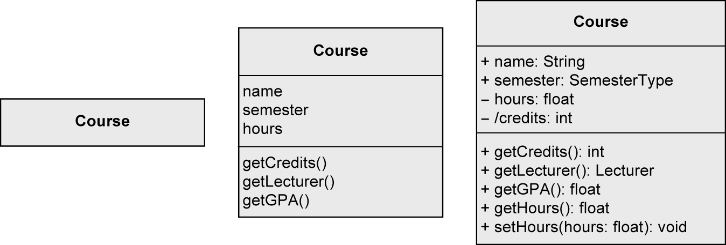
Specification of Classes: Different Levels of Detail
coarse-grained fine-grained

Slide 20
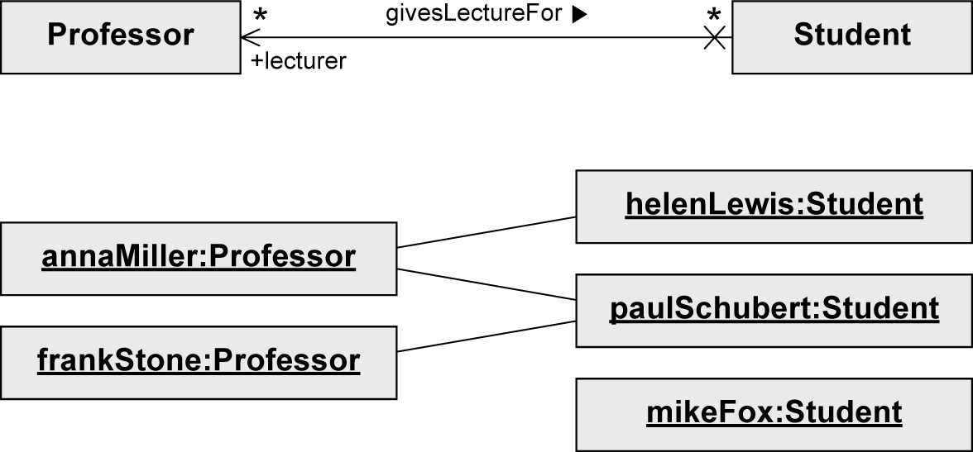
Association
Models possible relationships between instances of classes

Slide 21

Binary Association
Connects instances of two classes with one another
Navigability
Association name
Reading direction
Multiplicity
Non-navigability
Visibility
Role

Slide 22

Binary Association - Navigability
Navigability: an object knows its partner objects and can therefore access their visible attributes and operations
  Indicated by open arrow head
Non-navigability
  Indicated by cross
Example:
  A can access the visible attributes and
  operations of B
  B cannot access any attributes and
  operations of A
Navigability undefined
  Bidirectional navigability is assumed

Slide 23


Navigability – UML Standard vs. Best Practice
UML standard Best practice

Slide 24
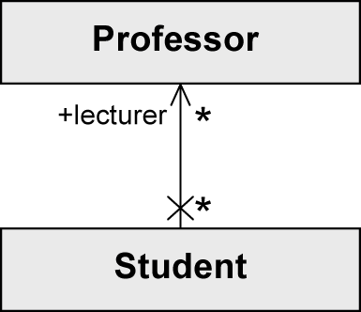
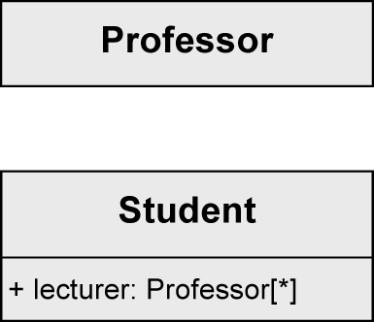
Binary Association as Attribute
Java-like notation:
Preferable
class Professor {…}
class Student{
public Professor[] lecturer;
…
}

Slide 25
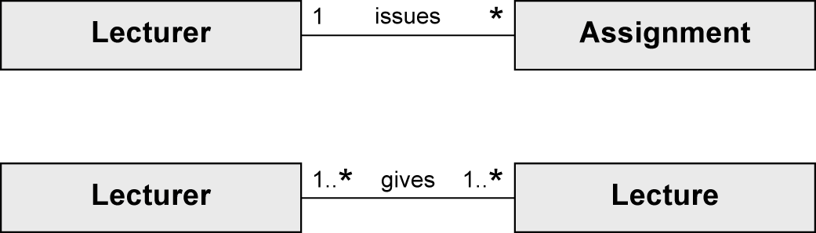
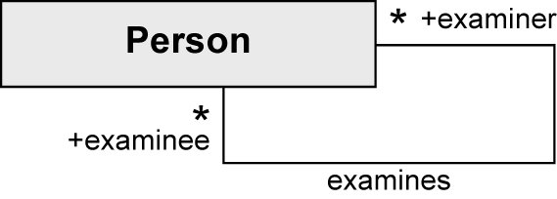
Binary Association – Multiplicity and Role
Multiplicity: Number of objects that may be associated with exactly one object of the opposite side
Role: describes the way in which an object is involved in an association relationship

Slide 26
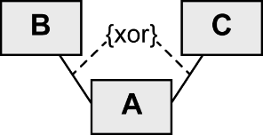
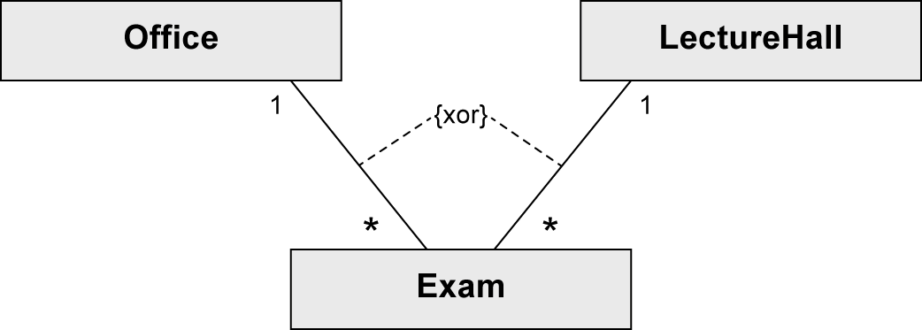
Binary Association – xor constraint
“exclusive or” constraint
An object of class A is to be associated with an object of class B or an object of class C but not with both.

Slide 27
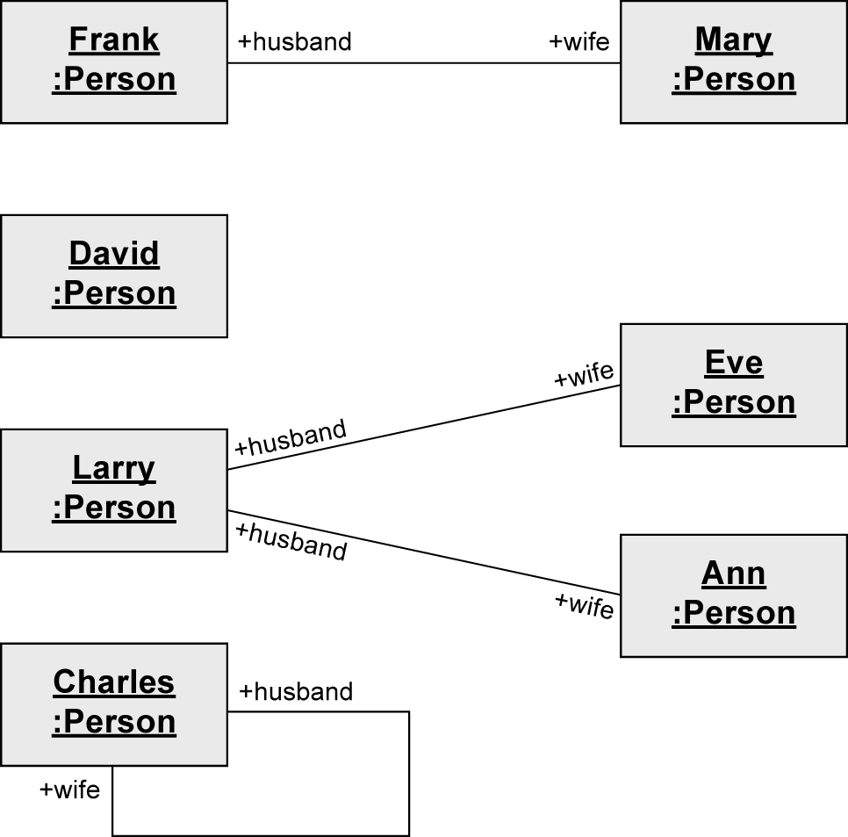

Unary Association - Example

Slide 28
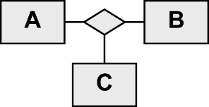
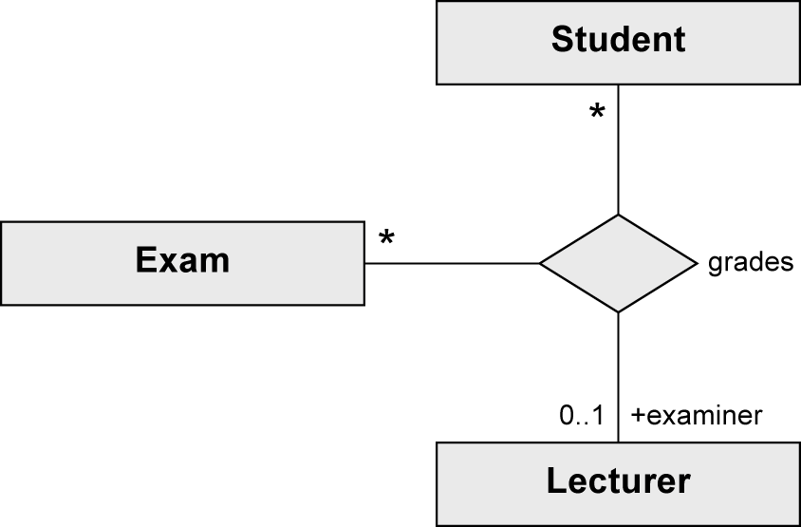
n-ary Association (1/2)
More than two partner objects are involved in the relationship.
No navigation directions
Ternary association

Slide 29
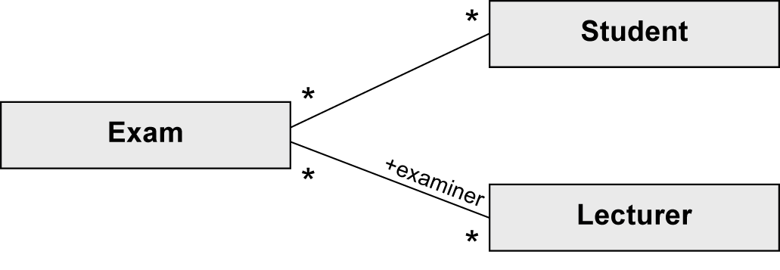
n-ary Association (2/2)
Example
  (Student, Exam) → (Lecturer)
    One student takes one exam with one or no lecturer
  (Exam, Lecturer) → (Student)
    One exam with one lecturer can be taken by any number of students
  (Student, Lecturer) → (Exam)
    One student can be graded by one Lecturer for any number of exams
≠

Slide 30
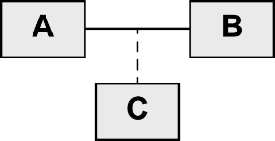
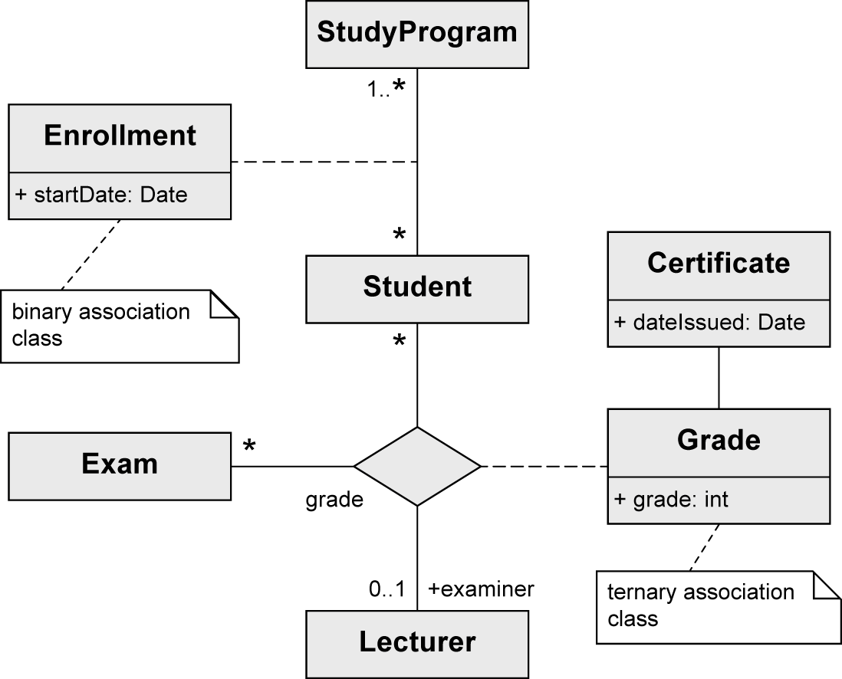
Association Class
Assign attributes to the relationship between classes rather than to a class itself

Slide 31
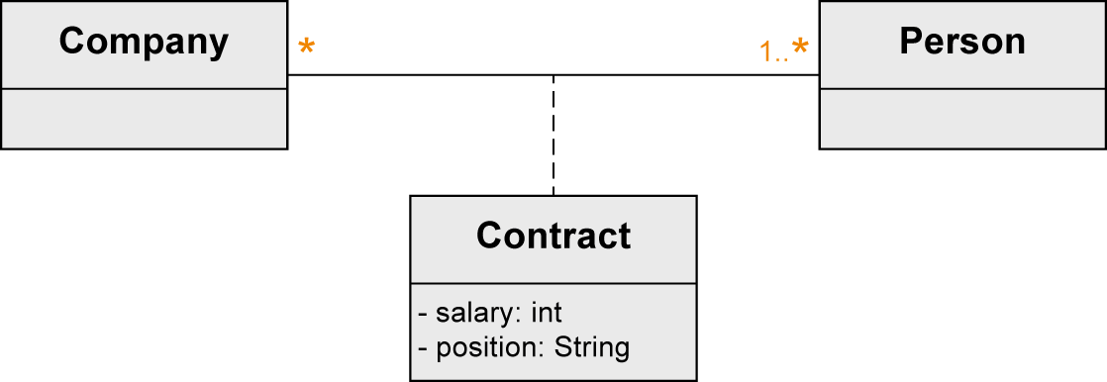
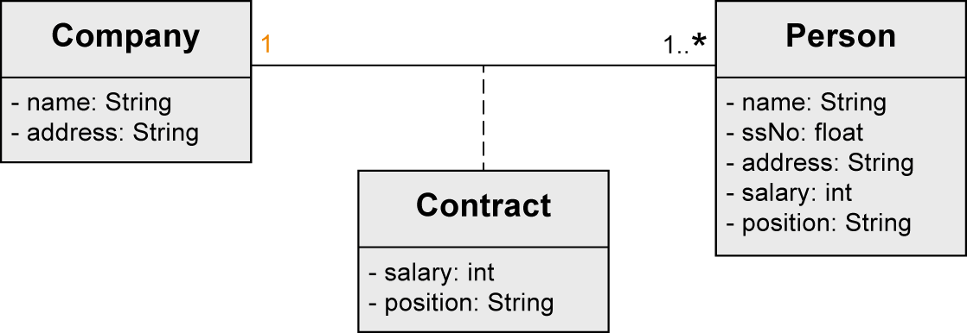
Association Class
Necessary when modeling n:m Associations
With 1:1 or 1:n possible but not necessary
Association class
X

Slide 32
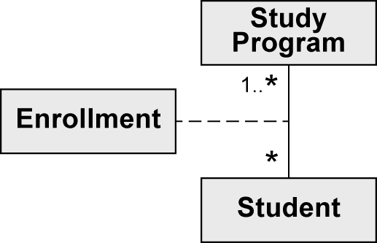
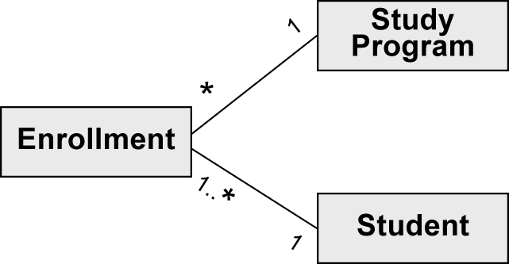
Association Class vs. Regular Class
≠
A Student can enroll for one
particular StudyProgram only
once
A Student can have mutiple
Enrollments for one and the
same StudyProgram

Slide 33
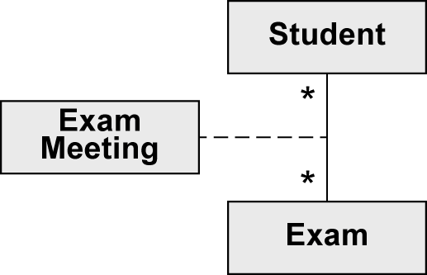
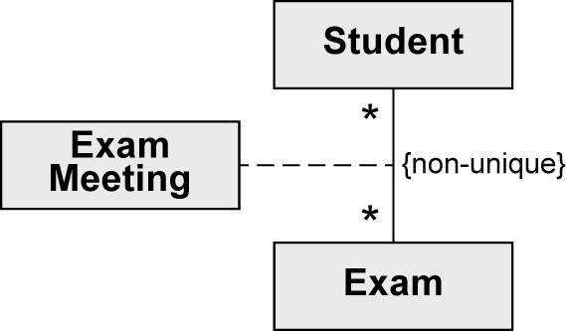
Association Class – unique/non-unique (1/2)
non-unique: duplicates allowed
Default: no duplicates
A student can only be granted an
exam meeting for a specific exam once.
A student can have more than one
exam meetings for a specific exam.

Slide 34
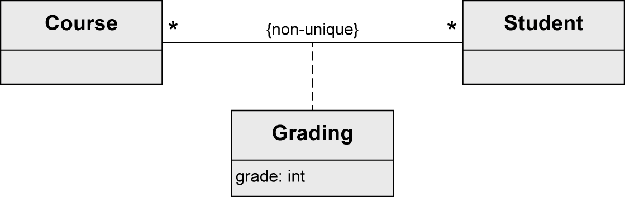
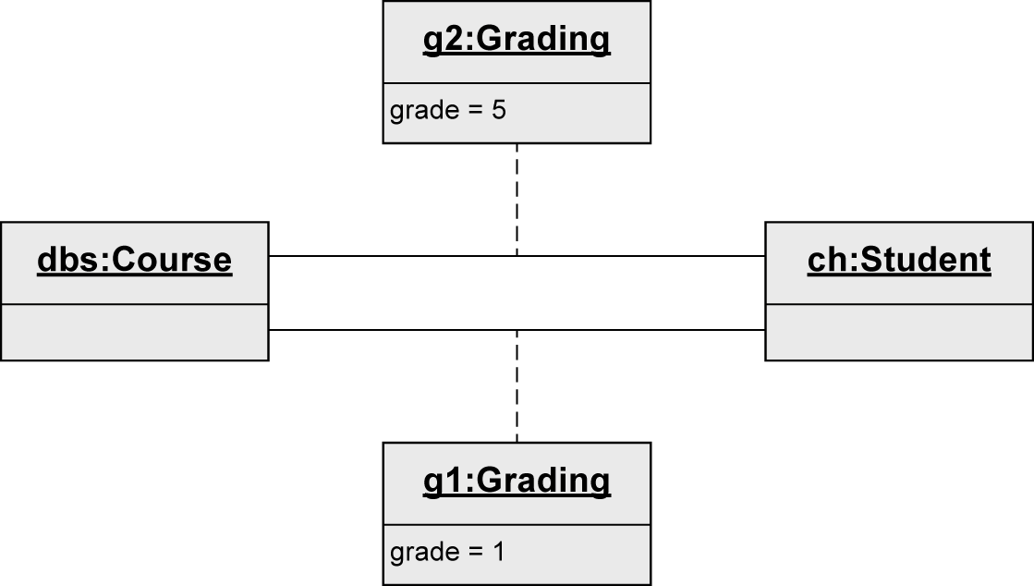
Association Class – unique/non-unique (2/2)
X

Slide 35
Aggregation
Special form of association
Used to express that a class is part of another class
Properties of the aggregation association:
  Transitive: if B is part of A and C is part of B, C is also part of A
  Asymmetric: it is not possible for A to be part of B and B to be part of A simultaneously.
Two types:
  Shared aggregation
  Composition

Slide 36

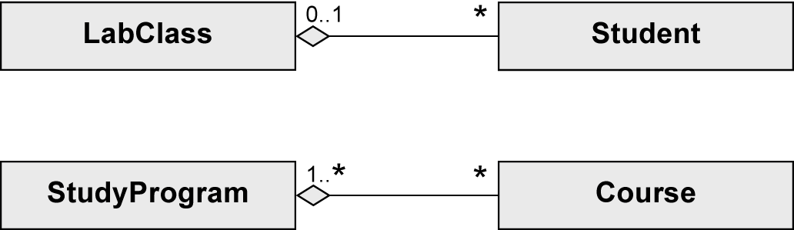
Shared Aggregation
Expresses a weak belonging of the parts to a whole
  = Parts also exist independently of the whole
Multiplicity at the aggregating end may be >1
  = One element can be part of multiple other elements simultaneously
Spans a directed acyclic graph
Syntax: Hollow diamond at the aggregating end
Example:
  Student is part of LabClass
  Course is part of StudyProgram

Slide 37

Composition
Existence dependency between the composite object and its parts
One part can only be contained in at most one composite object at one specific point in time
  Multiplicity at the aggregating end max. 1
  -> The composite objects form a tree
If the composite object is deleted, its parts are also deleted.
Syntax: Solid diamond at the aggregating end
Example: Beamer is part of LectureHall is part of Building
If the Building is deleted,
the LectureHall is also deleted
The Beamer can exist without the
LectureHall, but if it is contained in the
LectureHall while it is deleted, the Beamer
is also deleted

Slide 38
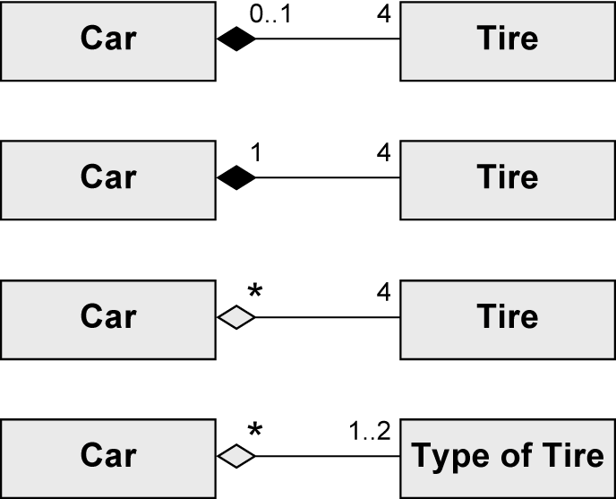
Shared Aggregation and Composition
Which model applies?

Slide 39
Shared Aggregation and Composition
Which model applys?
A Tire can exist without a Car. A Tire belongs to one Car at most.
----Yes---
A Tire cannot exist without a Car.
---------No--------
A Tire can belong to multiple Cars
A Car has one or two types of Tires. Several Cars may have the same Type of Tires.
----Yes---

Slide 40

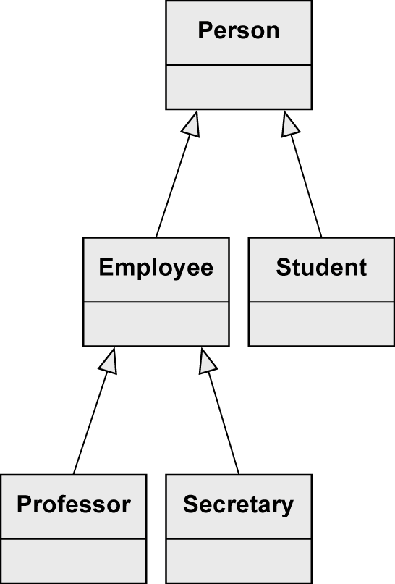
Generalization
Characteristics (attributes and operations), associations, and aggregations that are specified for a general class (superclass) are passed on to its subclasses.
Every instance of a subclass is simultaneously an indirect instance of the superclass.
Subclass inherits all characteristics, associations, and aggregations of the superclass except private ones.
Subclass may have further characteristics, associations, and aggregations.
Generalizations are transitive.
Superclass
Subclasses
…inherit characteristics,
associations, and
aggregations
A Secretary is
an Employee and
a Person

Slide 41
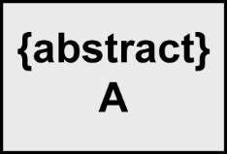


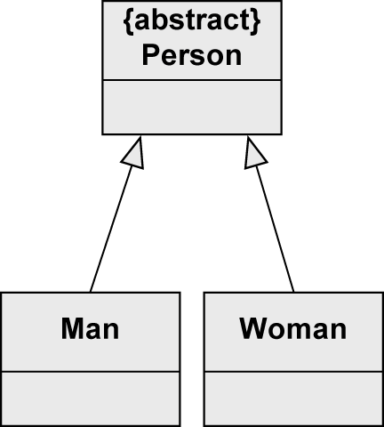
Generalization – Abstract Class
Used to highlight common characteristics of their subclasses.
Used to ensure that there are no direct instances of the superclass.
Only its non-abstract subclasses can be instantiated.
Useful in the context of generalization relationships.
Notation: keyword {abstract} or class name in italic font.
No Person-object possible
Two types of Person: Man and Woman

Slide 42

Generalization – Multiple Inheritance
UML allows multiple inheritance.
A class may have multiple superclasses.
Example:
A Tutor is both an Employee and a Student

Slide 43


With and Without Generalization

Slide 44

Creating a Class Diagram
Not possible to completely extract classes, attributes and associations from a natural language text automatically.
Guidelines
  Nouns often indicate classes
  Adjectives indicate attribute values
  Verbs indicate operations
Example: The library management system stores users with their unique ID, name and address as well as books with their title, author and ISBN number. Ann Foster wants to use the library.
Question: What about Ann Foster?

Slide 45
Example – University Information System
A university consists of multiple faculties which are composed of various institutes. Each faculty and each institute has a name. An address is known for each institute.
Each faculty is led by a dean, who is an employee of the university.
The total number of employees is known. Employees have a social security number, a name, and an email address. There is a distinction between research and administrative personnel.
Research associates are assigned to at least one institute. The field of study of each research associate is known. Furthermore, research associates can be involved in projects for a certain number of hours, and the name, starting date, and end date of the projects are known. Some research associates hold courses. Then they are called lecturers.
Courses have a unique number (ID), a name, and a weekly duration in hours.

Slide 46

Example – Step 1: Identifying Classes
A university consists of multiple faculties which are composed of various institutes. Each faculty and each institute has a name. An address is known for each institute.
Each faculty is led by a dean, who is an employee of the university.
The total number of employees is known. Employees have a social security number, a name, and an email address. There is a distinction between research and administrative personnel.
Research associates are assigned to at least one institute. The field of study of each research associate is known. Furthermore, research associates can be involved in projects for a certain number of hours, and the name, starting date, and end date of the projects are known. Some research associates hold courses. Then they are called lecturers.
Courses have a unique number (ID), a name, and a weekly duration in hours.
We model the system „University“
X
X
Dean has no further attributes than
any other employee

Slide 47

Example – Step 2: Identifying the Attributes
A university consists of multiple faculties which are composed of various institutes. Each faculty and each institute has a name. An address is known for each institute.
Each faculty is led by a dean, who is an employee of the university.
The total number of employees is known. Employees have a social security number, a name, and an email address. There is a distinction between research and administrative personnel.
Research associates are assigned to at least one institute. The field of study of each research associate is known. Furthermore, research associates can be involved in projects for a certain number of hours, and the name, starting date, and end date of the projects are known. Some research associates hold courses. Then they are called lecturers.
Courses have a unique number (ID), a name, and a weekly duration in hours.

Slide 48

Example – Step 2: Identifying Relationships (1/6)
Three kinds of relationships:
  Association
  Generalization
  Aggregation
Indication of a generalization
“There is a distinction between research
and administrative personnel.”
“Some research associates hold courses. Then they are called lecturers.”
Abstract, i.e., no other types
of employees

Slide 49

Example – Step 2: Identifying Relationships (2/6)
“A university consists of multiple faculties which are composed of various institutes.”
Composition to show existence
dependency

Slide 50

Example – Step 2: Identifying Relationships (3/6)
“Each faculty is led by a dean, who is an employee of the university”
In the leads-relationship, the
Employee takes the role of a dean.

Slide 51

Example – Step 2: Identifying Relationships (4/6)
“Research associates are assigned to at least one institute.”
Shared aggregation to show that ResearchAssociates
are part of an Institute,
but there is no existence dependency

Slide 52

Example – Step 2: Identifying Relationships (5/6)
“Furthermore, research associates can be involved in projects for a certain number of hours.”
Association class enables to store
the number of hours for every
single Project of every single
ResearchAssociate

Slide 53

Example – Step 2: Identifying Relationships (6/6)
“Some research associates hold courses. Then they are called lecturers.”
Lecturer inherits all characteristics,
associations, and aggregations from
ResearchAssociate.
In addtion, a Lecturer has an association
teaches to Course.

Slide 54

Example – Complete Class Diagram

Slide 55
Code Generation
Class diagrams are often created with the intention of implementing the modeled elements in an object-oriented programming language.
Often, translation is semi-automatic and requires only minimal manual intervention.

Slide 56




Code Generation – Example (1/6)
class Course {
public int courseNo;
}
class Course {
public int courseNo;
}
class Course {
public int courseNo;
}
class Course {
public int courseNo;
}

Slide 57



Code Generation – Example (2/6)
abstract class UniversityMember {
public String firstName;
public String lastName;
public int ssNo;
}
abstract class UniversityMember {
public String firstName;
public String lastName;
public int ssNo;
}
abstract class UniversityMember {
public String firstName;
public String lastName;
public int ssNo;
}
abstract class UniversityMember {
public String firstName;
public String lastName;
public int ssNo;
}

Slide 58



Code Generation – Example (3/6)
Enumeration ESemester {
winter,
summer
}
Enumeration ESemester {
winter,
summer
}
Enumeration ESemester {
winter,
summer
}
Enumeration ERole {
lecturer,
tutor,
examiner
}
Enumeration ERole {
lecturer,
tutor,
examiner
}

Slide 59




Code Generation – Example (4/6)
class Student extends UniversityMember {
public int matNo;
public CourseExecution [] completedCourses;
}
class Student extends UniversityMember {
public int matNo;
public CourseExecution [] completedCourses;
}
class Student extends UniversityMember {
public int matNo;
public CourseExecution [] completedCourses;
}
class Student extends UniversityMember {
public int matNo;
public CourseExecution [] completedCourses;
}
class Student extends UniversityMember {
public int matNo;
public CourseExecution [] completedCourses;
}

Slide 60





Code Generation – Example (5/6)
class Employee extends UniversityMember {
private int acctNo;
public int getAcctNo () {
return acctNo;
}
public CourseExecution [] courseExecutions;
}
class Employee extends UniversityMember {
private int acctNo;
public int getAcctNo {
return acctNo;
}
public CourseExecution [] courseExecution;
}
class Employee extends UniversityMember {
private int acctNo;
public int getAcctNo {
return acctNo;
}
public CourseExecution [] courseExecution;
}
class Employee extends UniversityMember {
private int acctNo;
public int getAcctNo {
return acctNo;
}
public CourseExecution [] courseExecution;
}
class Employee extends UniversityMember {
private int acctNo;
public int getAcctNo {
return acctNo;
}
public CourseExecution [] courseExecution;
}
class Employee extends UniversityMember {
private int acctNo;
public int getAcctNo {
return acctNo;
}
public CourseExecution [] courseExecution;
}

Slide 61







Code Generation – Example (6/6)
class CourseExecution {
public int year;
public ESemester semester;
public Student [] student;
public Course course;
public Hashtable support;
// Key: employee
// Value: (role, hours)
}
class CourseExecution {
public int year;
public ESemester semester;
public Student [] student;
public Course course;
public Hashtable support;
// Key: employee
// Value: (role, hours)
}
class CourseExecution {
public int year;
public ESemester semester;
public Student [] student;
public Course course;
public Hashtable support;
// Key: employee
// Value: (role, hours)
}
class CourseExecution {
public int year;
public ESemester semester;
public Student [] student;
public Course course;
public Hashtable support;
// Key: employee
// Value: (role, hours)
}
class CourseExecution {
public int year;
public ESemester semester;
public Student [] student;
public Course course;
public Hashtable support;
// Key: employee
// Value: (role, hours)
}
class CourseExecution {
public int year;
public ESemester semester;
public Student [] student;
public Course course;
public Hashtable support;
// Key: employee
// Value: (role, hours)
}
class CourseExecution {
public int year;
public ESemester semester;
public Student [] student;
public Course course;
public Hashtable support;
// Key: employee
// Value: (role, hours)
}
class CourseExecution {
public int year;
public ESemester semester;
public Student [] student;
public Course course;
public Hashtable support;
// Key: employee
// Value: (role, hours)
}

Slide 62



Notation Elements (1/3)
Name | Notation | Description
Class |  | Description of the structure and behavior of a set of objects
Abstract class |  | Class that cannot be instantiated
Association |  | Relationship between classes: navigability unspecified, navigable in both directions, not navigable in one direction
oder

Slide 63



Notation Elements (2/3)
Name | Notation | Description
n-ary association |  | Relationship between n (here 3) classes
Association class |  | More detailed description of an association
xor relationship |  | An object of C is in a relationship with an object of A or with an object of B but not with both

Slide 64
Notation Elements (3/3)
Name | Notation | Description
Shared aggregation |  | Parts-whole relationship (A is part of B)
Strong aggregation = composition |  | Existence-dependent parts-whole relationship (A is part of B)
Generalization |  | Inheritance relationship (A inherits from B)
Object |  | Instance of a class
Link |  | Relationship between objects

