Slide 1

Object-Oriented Modeling
Activity Diagram
Slides accompanying UML@Classroom
Version 1.0

Slide 2
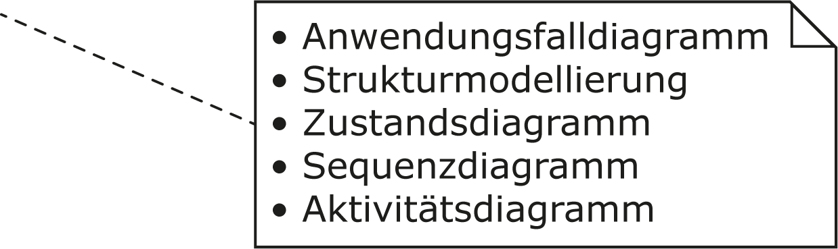
Literature
The lecture is based on the following book:
UML @ Classroom:
An Introduction to Object-Oriented Modeling
Martina Seidl, Marion Scholz, Christian Huemer and Gerti Kappel
Springer Publishing, 2015
ISBN 3319127411
Use Case Diagram
Structure Modeling
State Machine Diagram
Sequence Diagram
Activity Diagram

Slide 3
Content
Introduction
Activities
Actions
Edges
  Control flow
  Object flow
Initial node, activity final node, flow final node
Alternative paths
Concurrent paths
Object nodes
Event-based actions and call behavior actions
Partitions
Exception handling

Slide 4
Introduction
Focus of activity diagram: procedural processing aspects
Flow-oriented language concepts
Based on
  languages for defining business processes
  established concepts for describing concurrent communicating processes (token concept as found in petri nets)
Concepts and notation variants cover broad area of applications
  Modeling of object-oriented and non-object-oriented systems

Slide 5
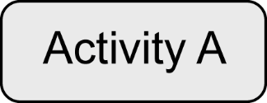
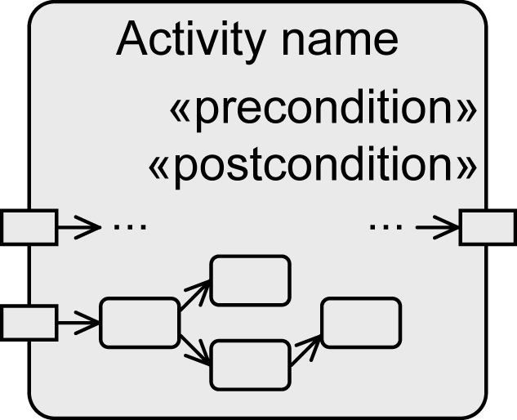
Activity
Specification of user-defined behavior at different levels of granularity
Examples:
  Definition of the behavior of an operation in the form of individual instructions
  Modeling the course of actions of a use case
  Modeling the functions of a business process
An activity is a directed graph
  Nodes: actions and activities
  Edges: for control and object flow
Control flow and object flow define
the execution
Optional:
  Parameter
  Pre- and postconditions
Output
parameter
Input
parameter
Node
Edge

Slide 6
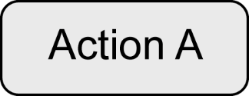
Action
Basic element to specify user-defined behavior
Atomic but can be aborted
No specific rules for the description of an action
→Definition in natural language or in any programming language
Process input values to produce output values
Special notation for predefined types of actions, most importantly
  Event-based actions
  Call behavior actions

Slide 7

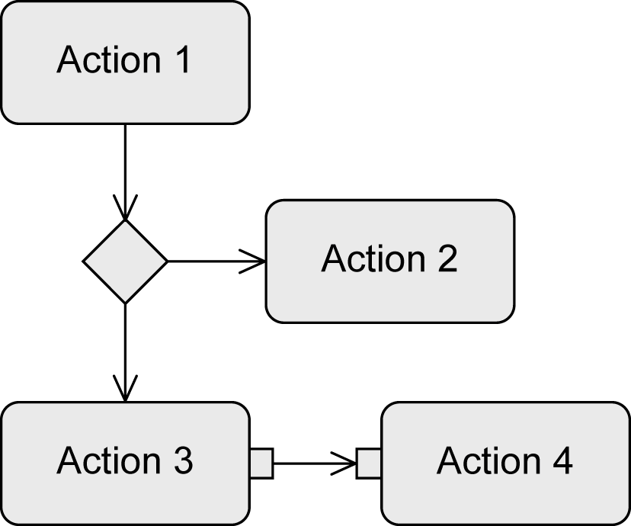

Edges
Connect activities and actions to one another
Express the execution order
Types
  Control flow edges
    Define the order between nodes
  Object flow edges
    Used to exchange data or objects
    Express a data/causal dependency between nodes
Guard (condition)
  Control and object flow only continue if
  guards in square brackets
  evaluate to true
Control flow
Object flow

Slide 8
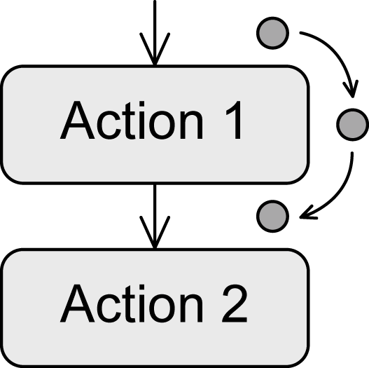
Token
Virtual coordination mechanism that describes the execution exactly
  No physical component of the diagram
  Mechanism that grants the execution permission to actions
If an action receives a token, the action can be executed
When the action has completed, it passes the token to a subsequent action and the execution of this action is triggered
Guards can prevent the passing of a token
  Tokens are stored in previous node
Control token and object token
  Control token: “execution permission" for a node
  Object token: transport data + “execution permission”

Slide 9



Beginning and Termination of Activities
Initial node
  Starts the execution of an activity
  Provides tokens at all outgoing edges
  Keeps tokens until the successive nodes accept them
  Multiple initial nodes to model concurrency
Activity final node
  Ends all flows of an activity
  First token that reaches the activity final node terminates the entire activity
    Concurrent subpaths included
  Other control and object tokens are deleted
    Exception: object tokens that are already present at the output parameters of the activity
Flow final node
  Ends one execution path of an activity
  All other tokens of the activity remain unaffected

Slide 10

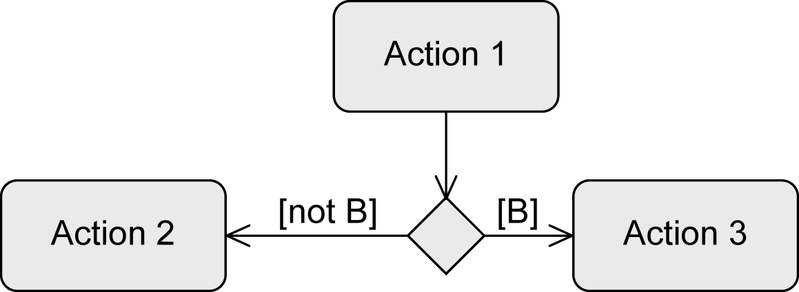
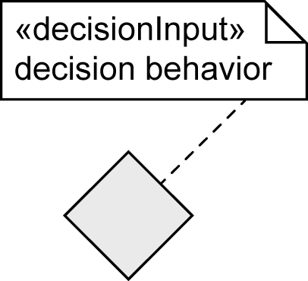
Alternative Paths – Decision Node
To define alternative branches
„Switch point“ for tokens
Outgoing edges have guards
  Syntax: [Boolean expression]
  Token takes one branch
  Guards must be mutually exclusive
  Predefined: [else]
Decision behavior
  Specify behavior that is necessary for the evaluation of the guards
  Execution must not have side effects

Slide 11

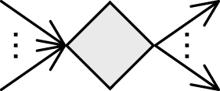
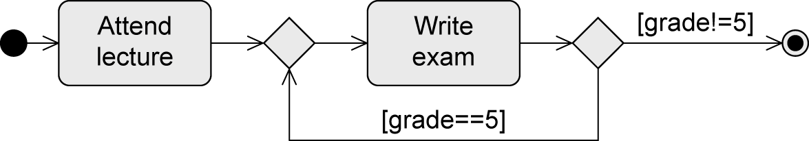
Alternative Paths – Merge Node
To bring alternative subpaths together
Passes token to the next node
Combined decision and merge node
Decision and merge nodes can also be used to model loops:

Slide 12
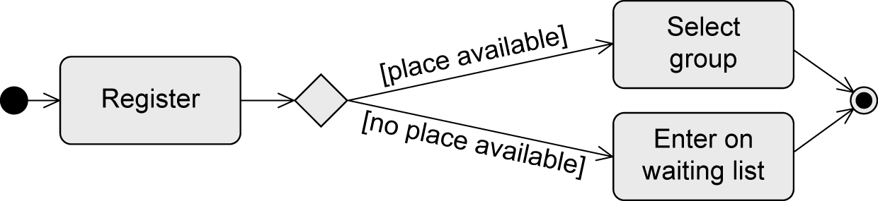
Example: Alternative Paths

Slide 13
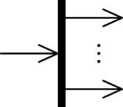
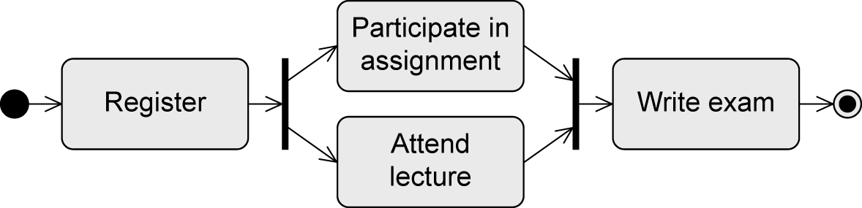
Concurrent Paths – Parallelization Node
To split path into concurrent subpaths
Duplicates token for all outgoing edges
Example:

Slide 14
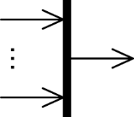
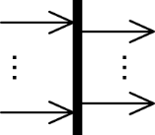
Concurrent Paths – Synchronization Node
To merge concurrent subpaths
Token processing
  Waits until tokens are present at all incoming edges
  Merges all control tokens into one token and passes it on
  Passes on all object tokens
Combined parallelization and synchronization node:

Slide 15
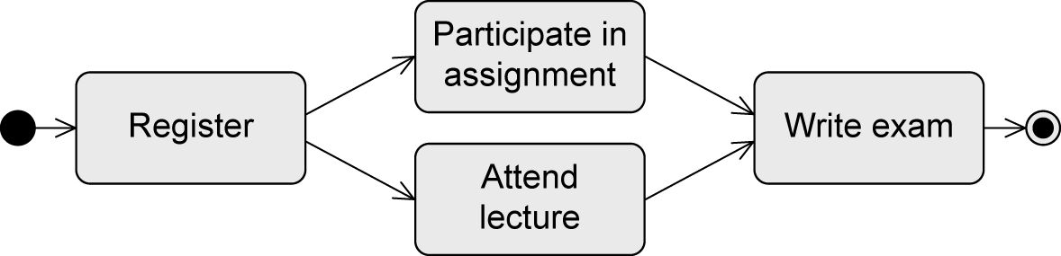
Example: Equivalent Control Flow
… equivalent to …

Slide 16
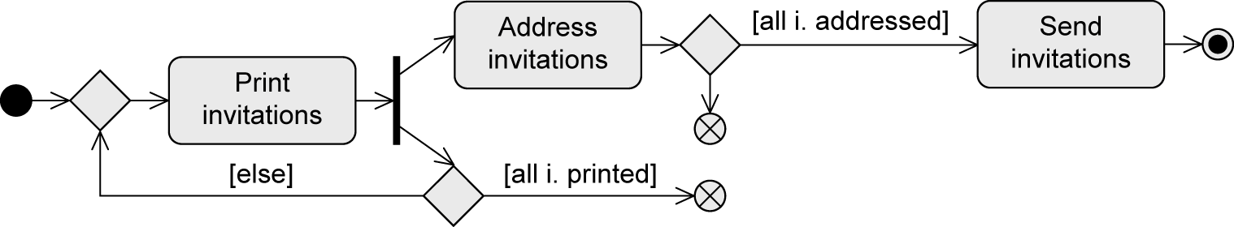
Example: Create and Send Invitations to a Meeting
While invitations are printed, already printed invitations are addressed.
When all invitations are addressed, then the invitations are sent.

Slide 17
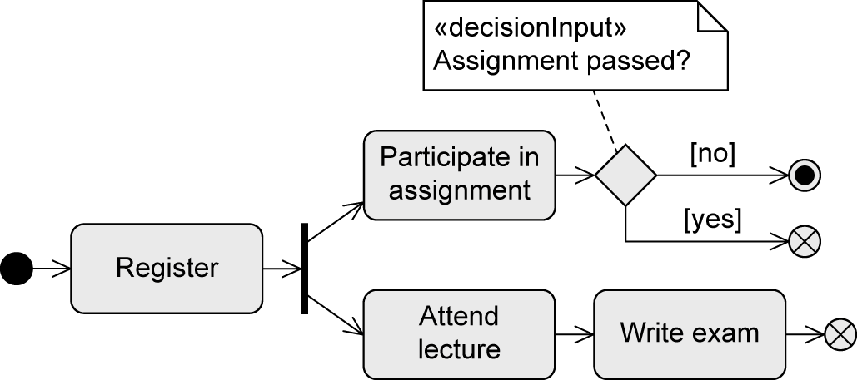
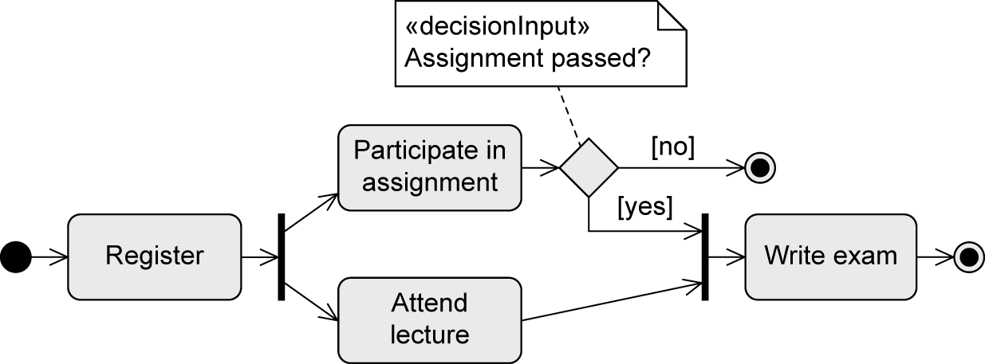
Example: Conduct Lecture (Student Perspective)
NOT equivalent … why?

Slide 18
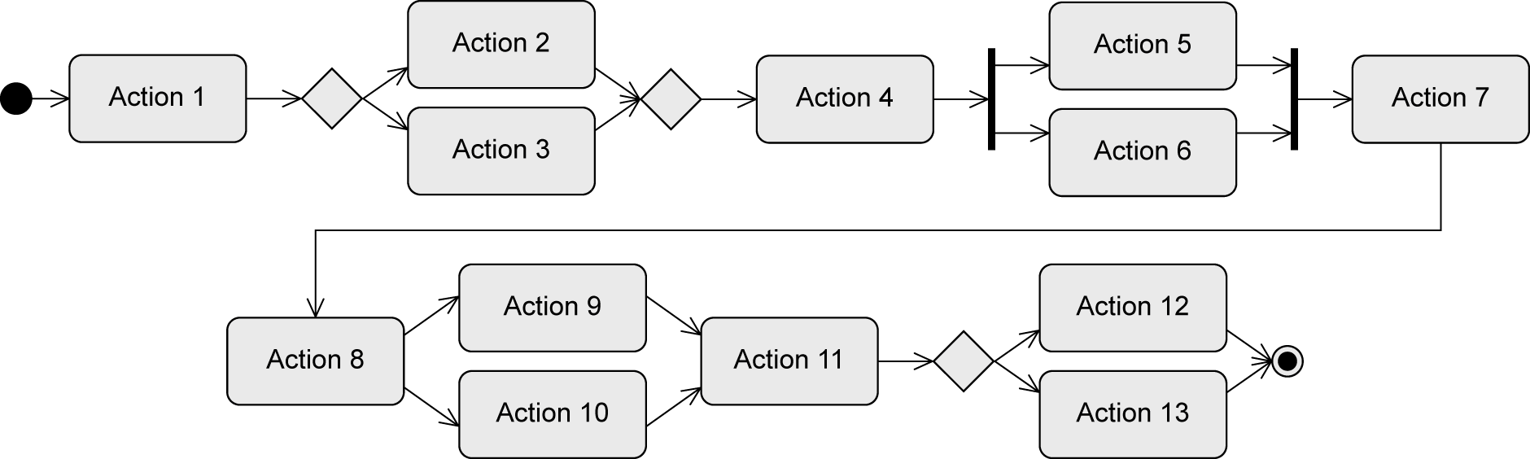
Example: Token (Control Flow)
x
x
x
x
x
x
x
x
x
x
x
x
x
x
x
x
End !
x
x
x
… all outgoing edges of all initial nodes are assigned a token….
… if all incoming edges of an action have a token, the action is activated and is ready for execution
… before the execution, the action consumes one token from every incoming edge;
after the execution, the action passes one token to every outgoing edge
… a decision node passes the token to one outgoing edge (depending on the result of the
evaluation of the guard)
… a merge node individually passes each token it gets to its outgoing edge
… a parallelization node duplicates an incoming token for all outgoing edges
… a synchronization node waits until all incoming edges have a token, merges them to a single
token and passes it to its outgoing edge
  … the first token that reaches the activity final node terminates the entire activity

Slide 19
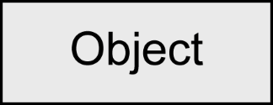
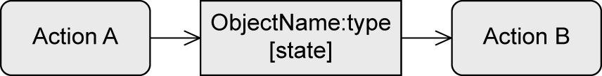
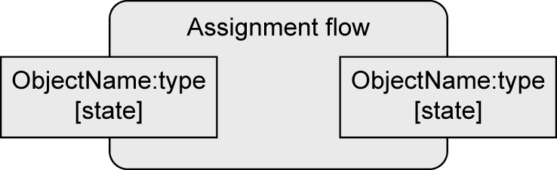
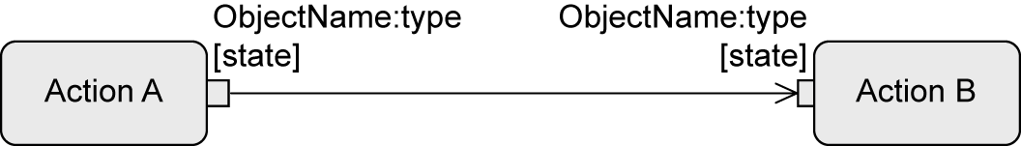
Object Node
Contains object tokens
Represents the exchange of data/objects
Is the source and target of an object flow edge
Optional information: type, state
Notation variant: object node as parameter
  For activities
  For actions (“pins”)
Input
parameter
Output
parameter

Slide 20
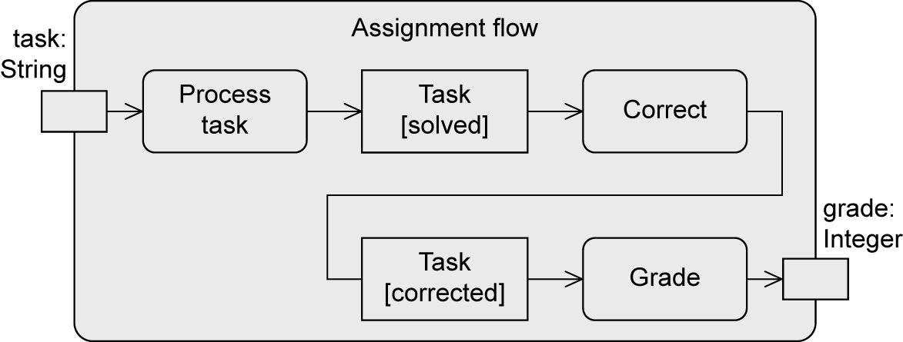
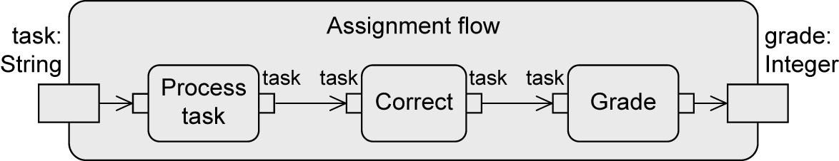
Example: Object Node

Slide 21
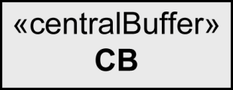
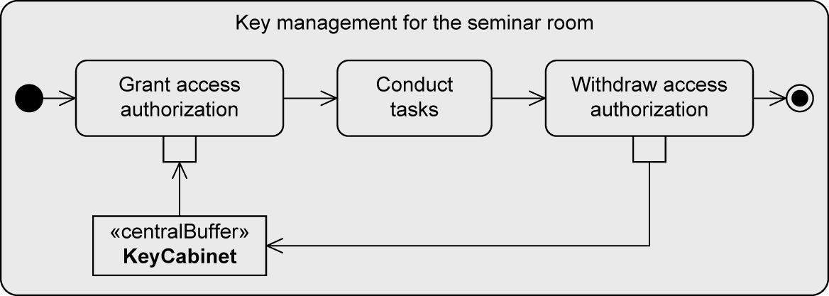
Central Buffer
For saving and passing on object tokens
Transient memory
Accepts incoming object tokens from object nodes and passes them on to other object nodes
When an object token is read from the central buffer, it is deleted from the central buffer and cannot be consumed again

Slide 22
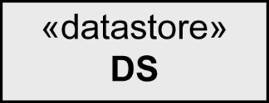
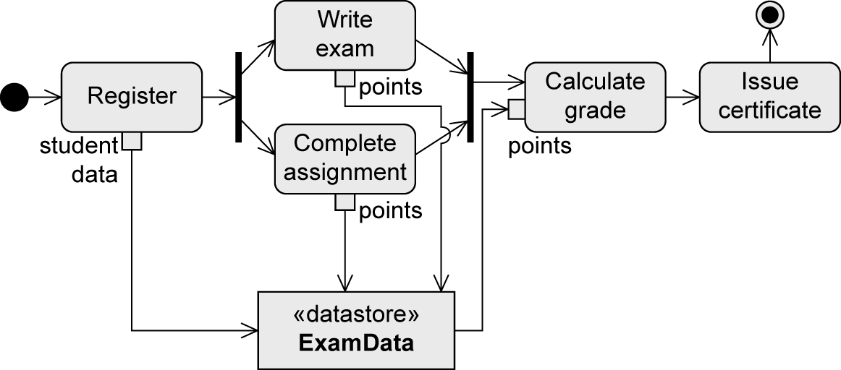
Data Store
For saving and passing on object tokens
Permanent memory
Saves object tokens permanently, passes copies to other nodes

Slide 23

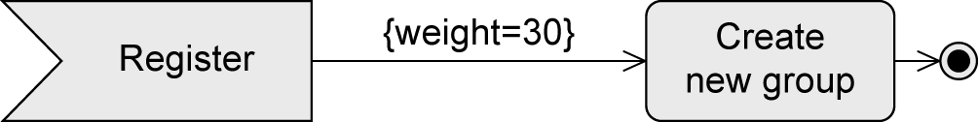
Weight of Edges
Minimal number of tokens that must be present for an action to be executed
Default: 1
All tokens present have to be consumed: 0 (also all or *)

Slide 24

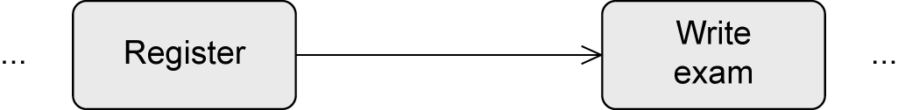
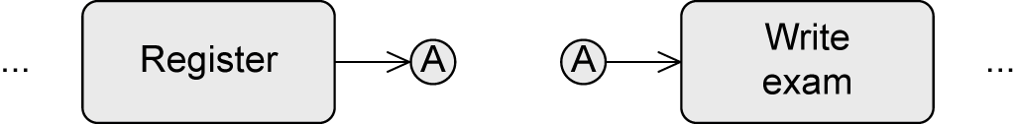
Connector
Used if two consecutive actions are far apart in the diagram
Without connector:
With connector

Slide 25
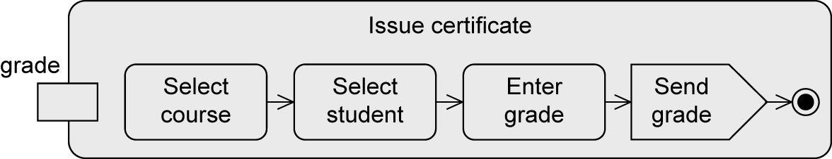
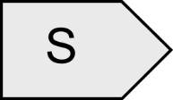

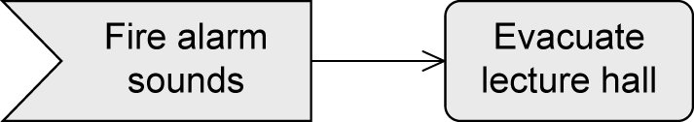
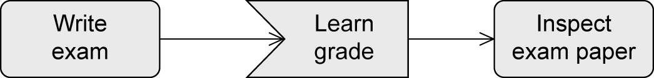

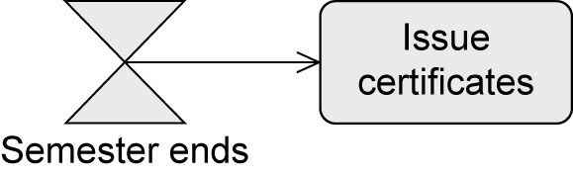
Event-Based Actions
To send signals
  Send signal action
To accept events
  Accept event action
  Accept time event action

Slide 26
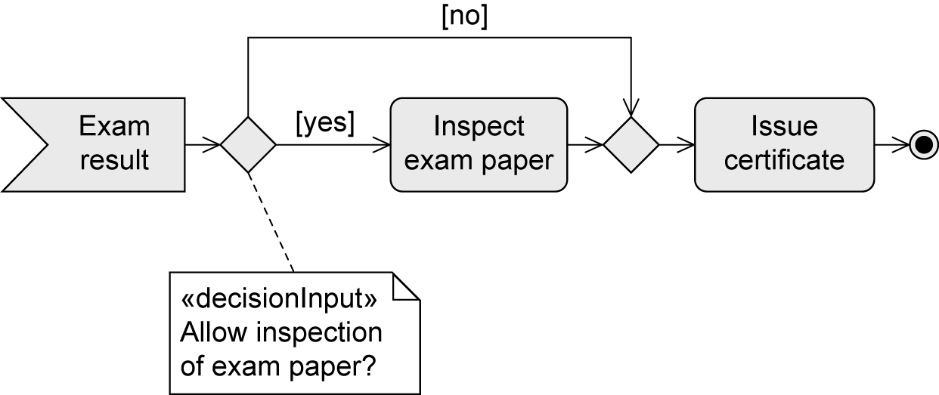
Example: Accept Event Action

Slide 27
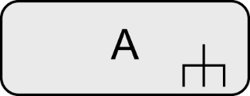
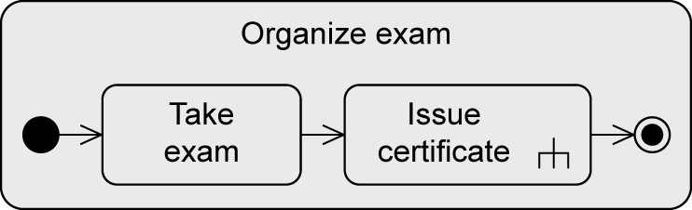
Call Behavior Action
The execution of an action can call an activity
Content of the called activity can be modeled elsewhere
Advantages:
  Model becomes clearer
  Reusability
Name of the called activity
Inverted fork symbol

Slide 28
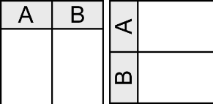
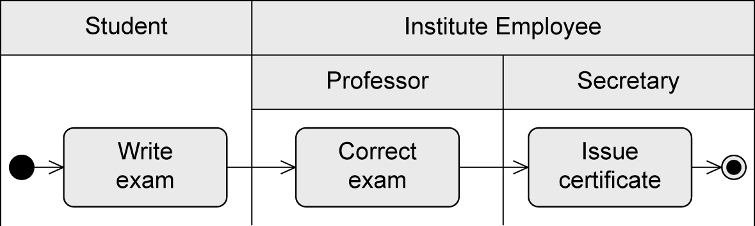
Partition
“Swimlane”
Graphically or textual
Allows the grouping of nodes and edges of an activity due to responsibilities
Responsibilities reflect organizational units or roles
Makes the diagram more structured
Does not change the execution semantics
Example: partitions Student and Institute Employee (with subpartitions Professor and Secretary)

Slide 29
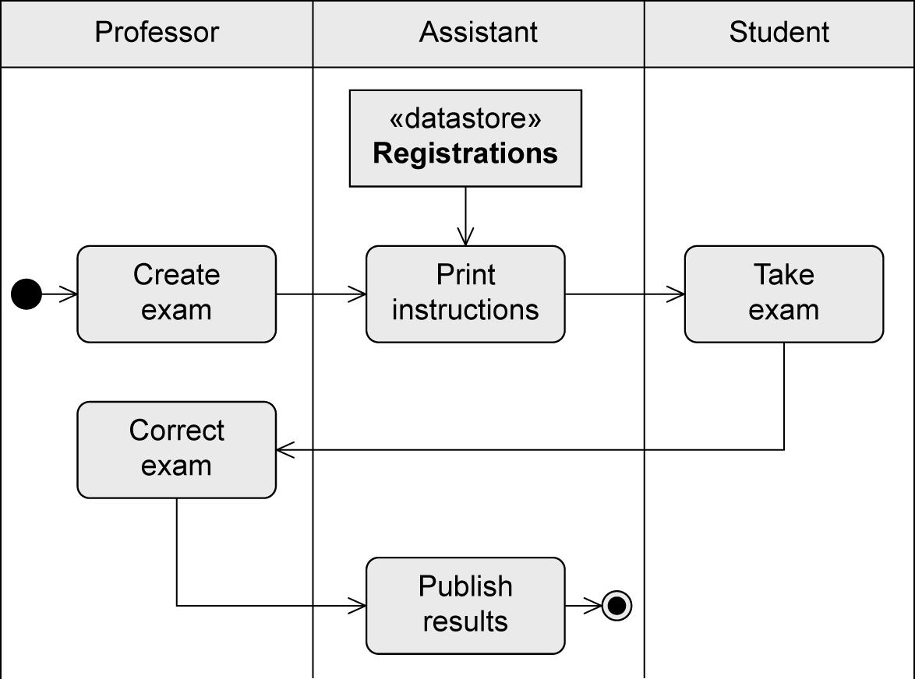
Example: Partitions

Slide 30
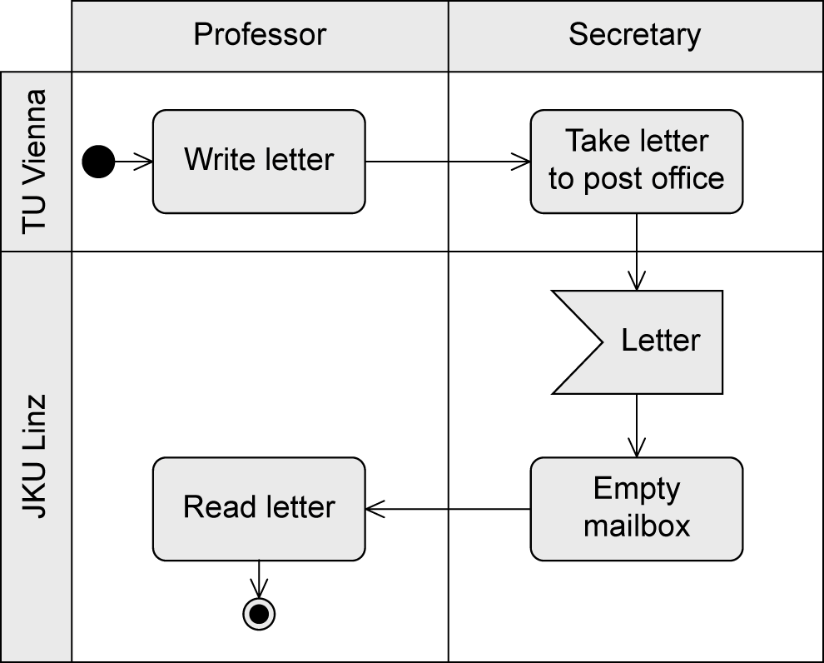
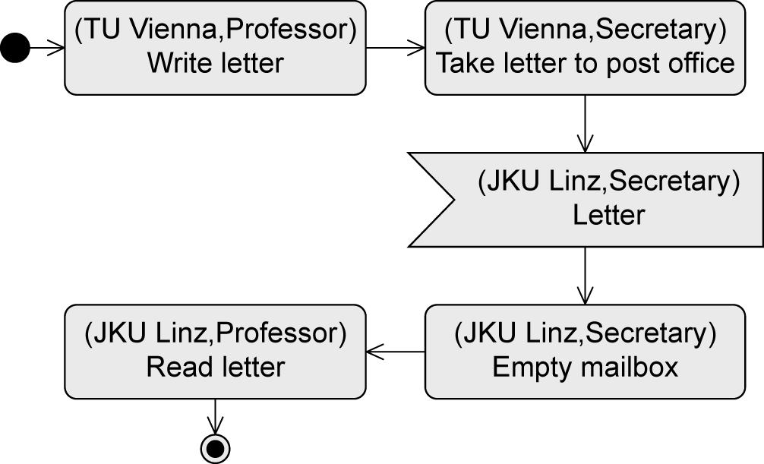
Multidimensional Partitions
Graphical notation … or alternatively textual notation

Slide 31
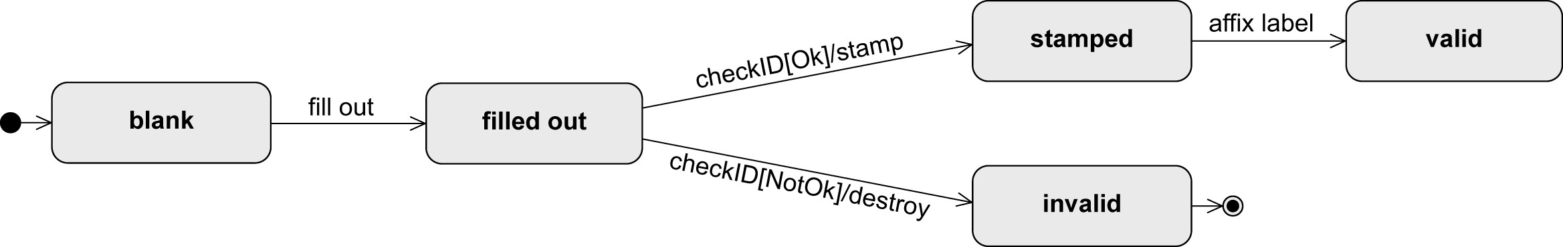
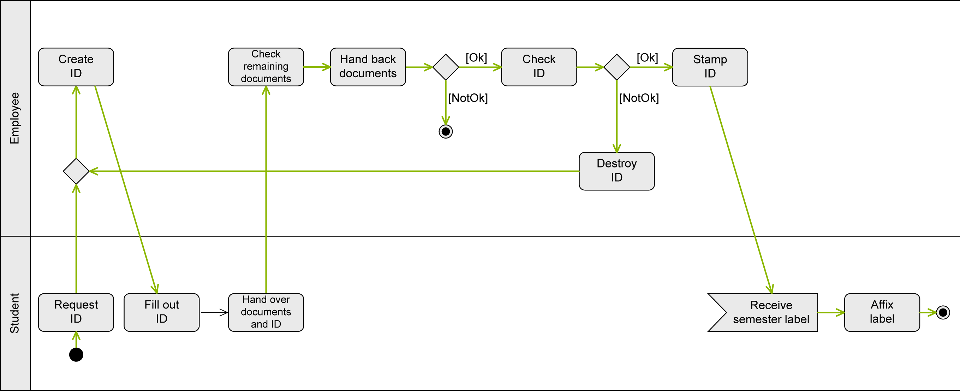
Example: Issue Student ID on Paper (1/2)
State machine diagram of Student ID:
Activity diagram – control flow:

Slide 32
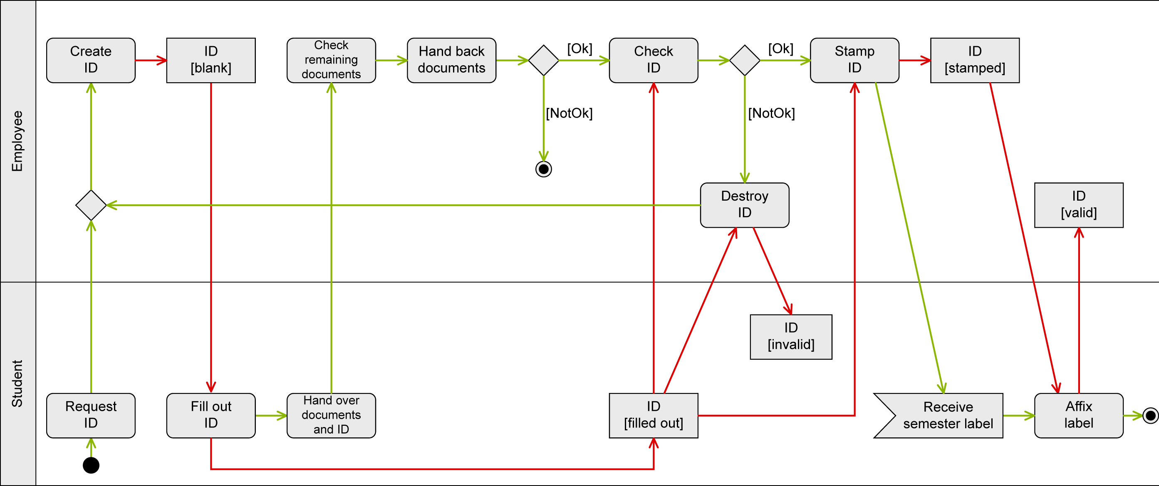
Example: Issue Student ID on Paper (2/2)
Control flow (green) and object flow (red) in one activity diagram

Slide 33
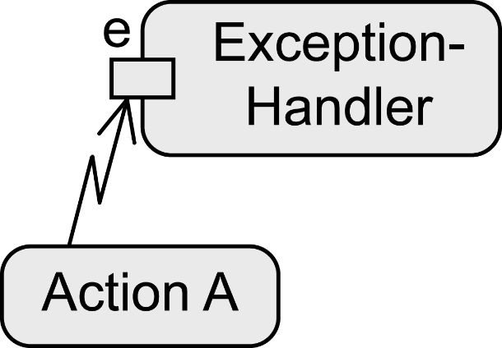
Exception Handling – Exception Handler
Predefined exceptions
Defining how the system has to react in a specific error situation
The exception handler replaces the action where the error occurred
If the error e occurs…
  All tokens in Action A are deleted
  The exception handler is activated
  The exception handler is executed instead of Action A
  Execution then continues regularly

Slide 34

Example: Exception Handler

Slide 35

Exception Handling– Interruptible Activity Region
Defining a group of actions whose execution is to be terminated immediately if a specific event occurs. In that case, some other behavior is executed
If E occurs while B or C are executed
  Exception handling is activated
  All control tokens within the dashed rectangle (= within B and C) are deleted
  D is activated and executed
No “jumping back” to the regular execution!

Slide 36

Example: Interruptible Activity Region

Slide 37


Notation Elements (1/5)
Name | Notation | Description
Action node Activity node |  | Represents an action (atomic!) Represents an activity (can be broken down further)
Initial node |  | Start of the execution of an activity
Activity final node |  | End of ALL execution paths of an activity

Slide 38

Notation Elements (2/5)
Name | Notation | Description
Decision node Merge node |  | Splitting of one execution path into alternative execution paths Merging of alternative execution paths into one execution path
Parallelization node Synchronization node |  | Splitting of one execution path into concurrent execution paths Merging of concurrent execution paths into one execution path

Slide 39

Notation Elements (3/5)
Name | Notation | Description
Flow final node |  | End of ONE execution path of an activity
Edge |  | Connection between the nodes of an activity
Call behavior action |  | Action A refers to an activity of the same name
Partition |  | Grouping of nodes and edges within an activity

Slide 40



Notation Elements (4/5)
Name | Notation | Description
Send signal action |  | Transmission of a signal to a receiver
Asynchronous accept (timing) event action |  | Wait for an event E or a time event T
Object node |  | Contains data or objects
Parameter for activities Parameter for actions (pins) |  | Contains data and objects as input and output parameters

Slide 41


Notation Elements (5/5)
Name | Notation | Description
Exception Handler |  | Exception handler is executed instead of the action in the event of an error e
Interruptible activity region |  | Flow continues on a different path if event E is detected

